Slide 1
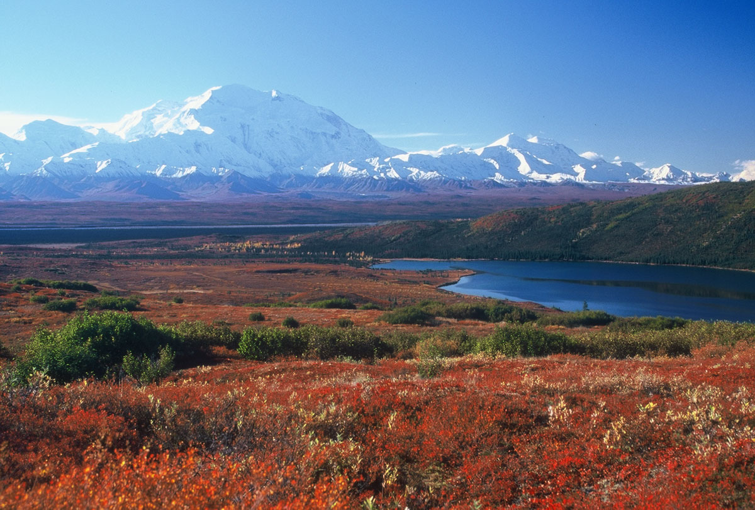
Tundra

Slide 2
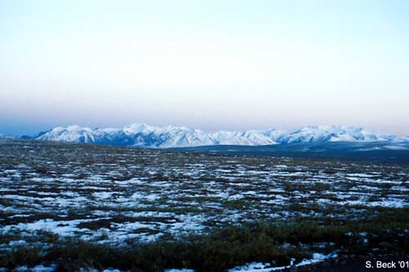
Climate
The tundra is drier and
colder than deserts. Known
as a “polar desert”
Temperature
Cool summers
Long severe winters(10+ months)
Summer days of 24 hour sun
Winter days of complete darkness
Can be very windy
Rainfall
4-10 inches of annual rainfall
Permafrost; ground below a few feet is frozen year round
Ground can be very wet in summer, because melted snow is not absorbed by permafrost and low temperatures prevent evaporation

Slide 3
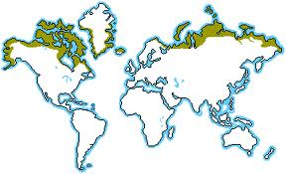
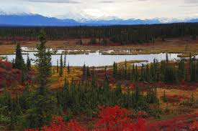
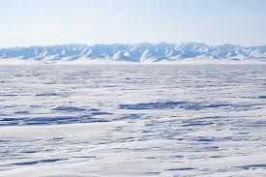
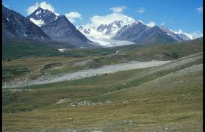
Locations
Extreme Northern Latitudes
Alaska
Canada
Greenland
Siberia(Russia)

Slide 4
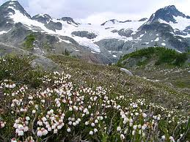
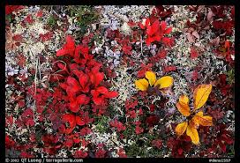
May
Plants
Survival depends on being
able to survive extremely
cold temperatures and short
growing season
Adaptations
Small and low growing, so they don’t freeze
Shallow roots that cannot penetrate the permafrost(the reason there aren’t trees)
Plants are dark in color, often red,
to absorb sun’s heat
May have hairs to keep plants warm
May grow in clumps to keep warm
Fragile ecosystem due to short
growing season

Slide 5
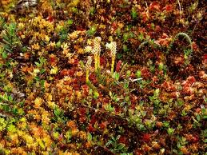
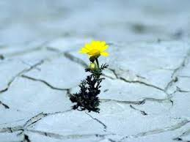
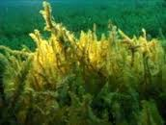
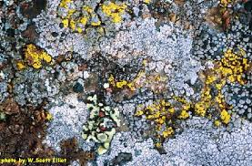
Examples: lichens, mosses, grasses, sedges

Slide 6
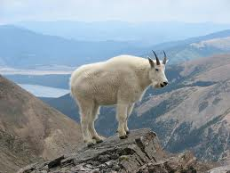
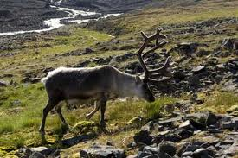
Animals
Must be able to
survive extreme cold
environment
Adaptations:
May have white coats to camouflage during winter
Have thick fur to reduce direct skin exposure to cold
May hibernate during winter when food supplies are low
Some animals my migrate away from the harsh climate during the winter
Cannot have deep burrows, due to permafrost
No amphibians or reptiles(cannot handle the harsh environment)

Slide 7
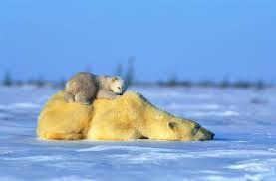
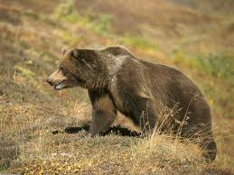
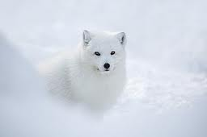
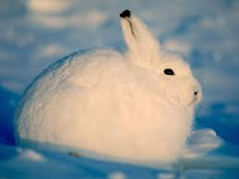
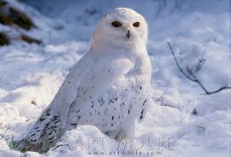
Examples: caribou(reindeer), musk ox, arctic foxes, hares, polar bears, grizzly bears, water fowl(ducks), owls

