Slide 1
The house
By: Savannah and David

Slide 2
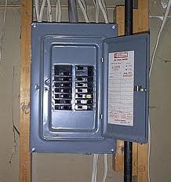
Fuse box (The nucleus)
It’s the main control of turning the electricity on and off

Slide 3
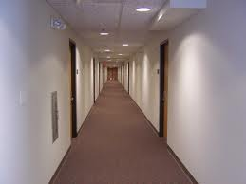
Hallways (Cytoplasm)
Allows you to move around in the house, helps support the house.

Slide 4
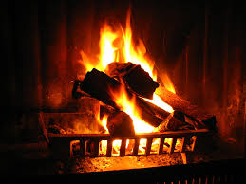
Fire place (Mitochondria)
It releases energy, stored in the fire wood.

Slide 5
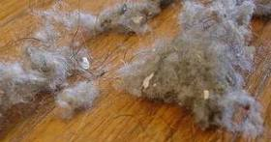
Dust (Ribosome)
Dust is a small particle, and usually found inside of the fuse box.

Slide 6
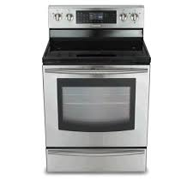
Oven (Chloroplast)
Food is produced from the oven.

Slide 7
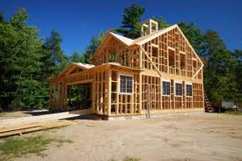
The frame (Cell wall)
It holds the house up, and is on the outside of the cell membrane.

Slide 8
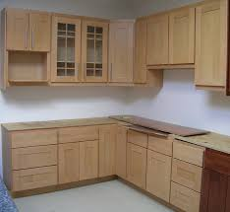
Cabinets (Vacuole)
It stores the food.

Slide 9
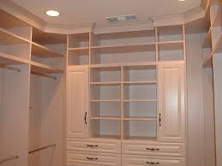
Closet (Golgi body)
The closet helps you sort your clothes and package them.

Slide 10
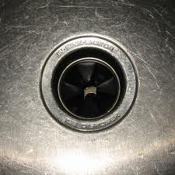
Garbage disposal (Lysosome)
The garbage disposal breaks down the food.

Slide 11
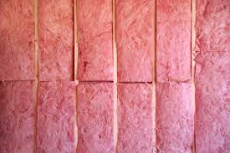
Insulation (Cell membrane)
The insulation is the barrier around the house, that keeps the house warm.

