Slide 1
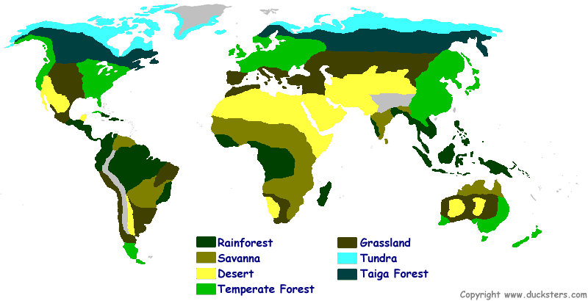
Terrestrial Biomes of The World

Slide 2
Deserts

Slide 3
Climate
Deserts are arid and
tend to be windy
Temperature
Can vary greatly depending on location
Can be very hot or very cold
Some hot deserts get very cold at night
Lack of clouds to absorb/hold in heat
Rainfall
Deserts are classified as areas as having less than 25 cm(10 inches) of annual rainfall
Most deserts receive less than 10 cm of rain per year
Can be in the form of rain, snow, or heavy thunderstorms

Slide 4
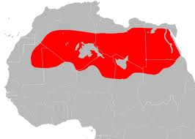
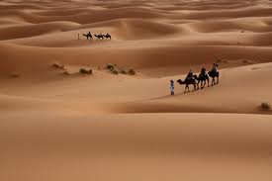
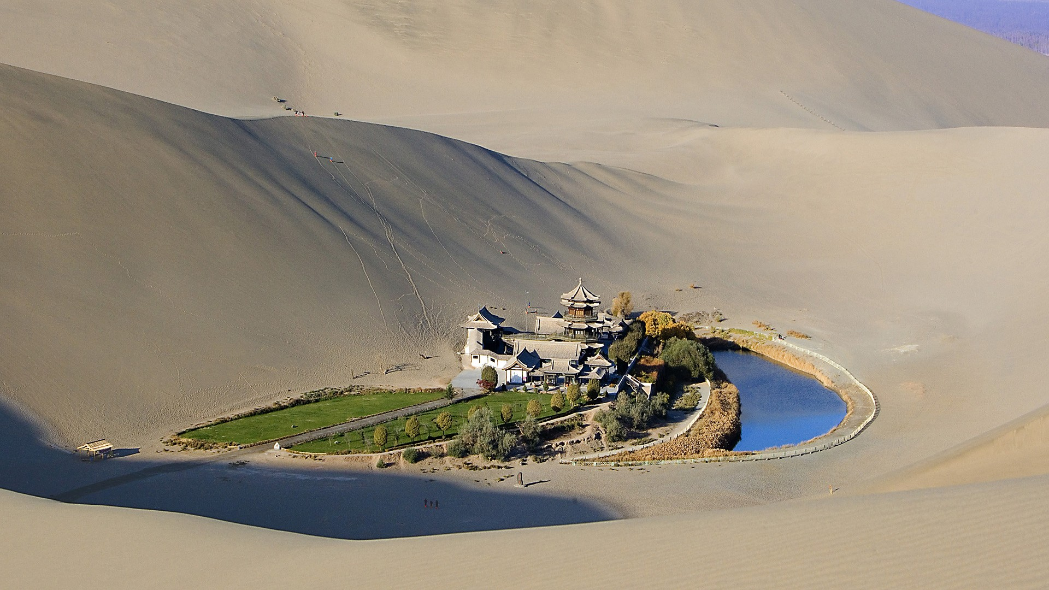
Locations
Hot Deserts
Sahara: Northern Africa
Southwest US and Mexico
Cold Deserts
Northwest US
Gobi: Central Asia

Slide 5
Plants
Tend to be spread
out
Adaptations
Very small thick leaves that do not lose water easily(often spines)
May lose leaves in the dry season
Can store water in leaves, stems, and roots
Seeds may lie dormant for extended periods
Spines prevent animals form eating leaves
Examples: cacti, sagebrush, lichens, aloe vera

Slide 6
Animals
Many species of animals
are found in the desert, but they are small, scattered populations
Adaptations:
Smaller in size
Inactive during the hottest parts of the day(nocturnal);
May spend their days in underground burrows
Can survive on very little water(get it from food)
Outer skin resistant to water loss
Examples: snakes, insects, lizards, small mammals, birds

Slide 7
Grasslands

Slide 8
Climate
Grasslands tend to be wetter
than deserts and drier than
forests
Temperature
Can have very hot summers and very cold winters
Can be very windy(because of lack of barriers like mountains and trees)
Rainfall
Grasslands receive between 25 and 75 cm(10-30 inches)
of precipitation per year
In northern temperate grasslands, snow may be the main
form of precipitation; in warmer regions it’s mainly rain
May be dry a good portion of the year, leading to fires.
Recurring fires keep out large trees and enrich the soil.

Slide 9
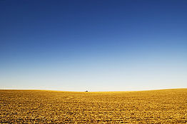
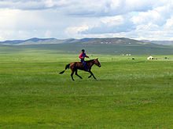
Locations
Grasslands are found on every continent(except Antarctica) and have many names, depending on where they are located
Steppe: Northern/Central Asia(cold/dry)
Prairies: Northern/Central US(temperate)
Savanna: Africa(tropical)
Pampas: South America

Slide 10
Plants
Grasses make up 60-90% of
the vegetation
Adaptations
The roots of grasses and other small plants make a thick network under the soil to trap moisture
Soil is thick and rich from decaying grasses and their roots
Trees that do live in grasslands tend to be fire resistant and live near sources of water
***In N. America most grasslands have been turned into
farmland

Slide 11
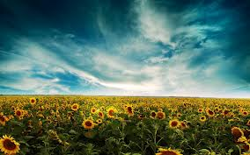
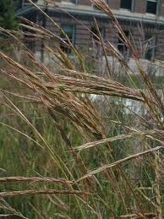
Examples of Plants
Examples: N. America: Big Bluestem, coneflowers,
sunflowers, milkweed

Slide 12
Animals
Large herds of migratory herb-
ivores dominate grasslands
Adaptations:
All animals must adapt to limited water supplies by having the ability to migrate to available water sources
predator and prey have the ability to run fast to obtain food or avoid being eaten, as well as to escape frequent fires
many use camouflage to hide from predator or prey
animals may burrow to escape the harsh environment and predators

Slide 13
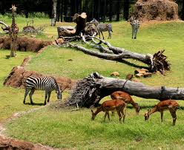
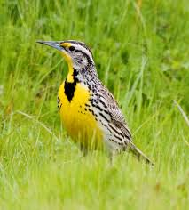
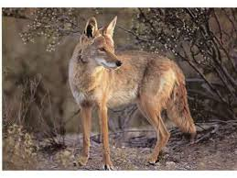
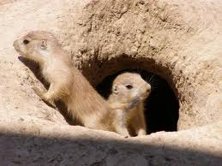
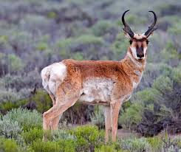
grazing: bison, elephants, pronghorn, zebra predators: wolves, lions, cheetahs, coyotes burrowing: prairie dogs, ferrets large numbers of birds and insects
Examples

