Slide 1
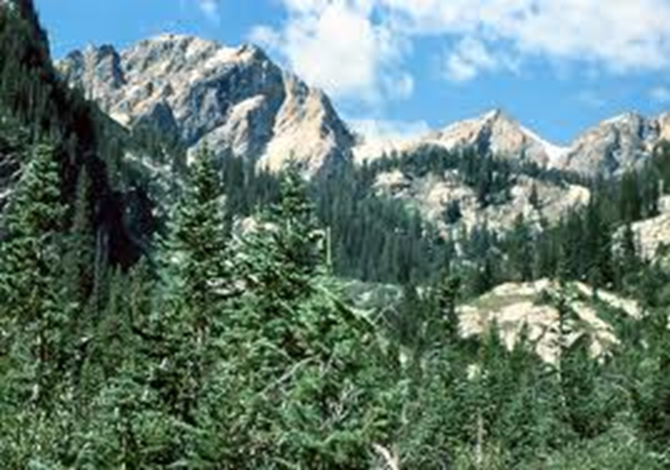
Taiga (aka Northern coniferous or boreal forest)

Slide 2
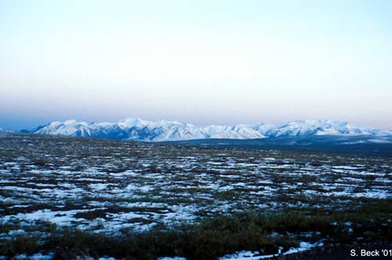
Climate
short cool summers and
long harsh winters with
plentiful snow
Temperature
Soil freezes in winter
Winters may last more than 6 months
humid, because temperatures are low enough all year to prevent evaporation
Rainfall
25-100 cm of precipitation per year(mostly snow)
Many lakes, ponds, and bogs

Slide 3
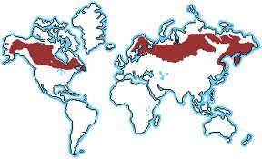
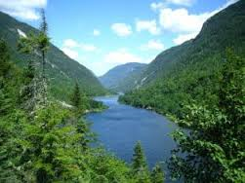
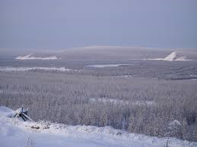
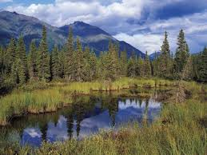
Locations
Southern ½ of Canada
Northern Europe
Much of Russia

Slide 4
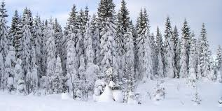
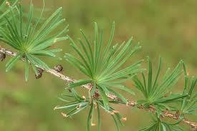
Plants
Must adapt to snowy
winters, which may
be “dry” for trees
(moisture doesn’t soak into ground)
Adaptations
needles prevent water loss
larches lose needles in fall
flexible branches bend under heavy snow
snow slides off of pyramid shaped trees

Slide 5
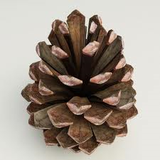
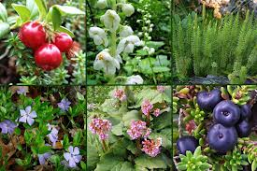
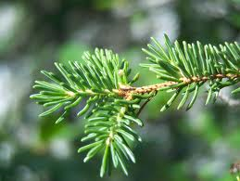
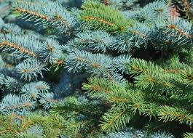
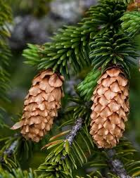
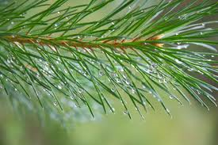
Firs, spruces, larches, blueberries
Examples

Slide 6
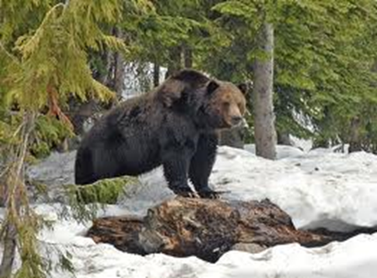
Animals
Must adapt to long
winters
Adaptations:
active in summer(may hibernate in winter)
birds migrate to warmer climates in winter
few reptiles and amphibians because of cold

Slide 7
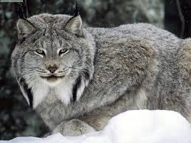
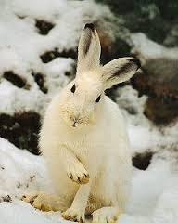
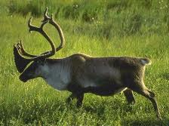
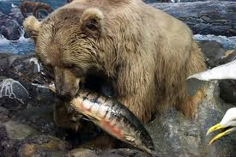
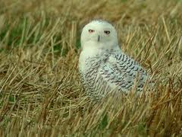
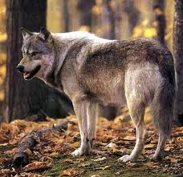
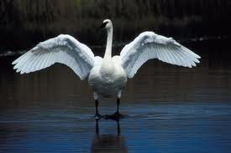
Woodpeckers, grouse owls are year round residents. Deer, caribou, moose, wolves, small rodents.
Examples

