Slide 1
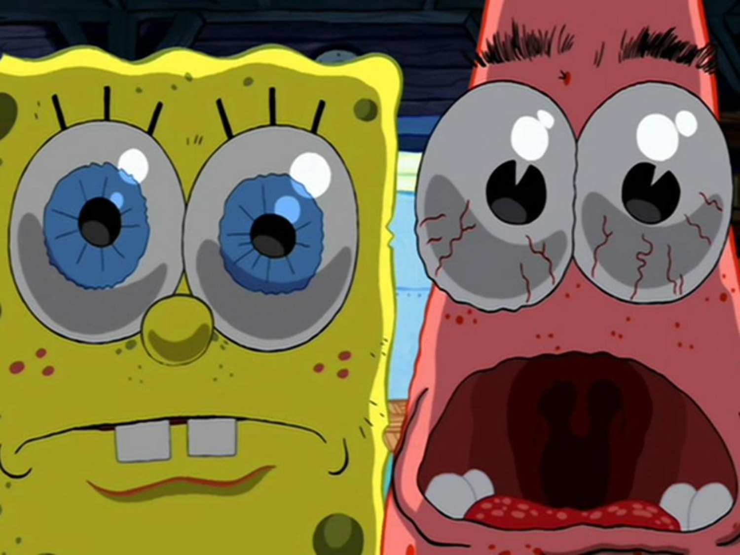
The amazing world of cell function
By Alex Sellie and Rebecca Waje

Slide 2
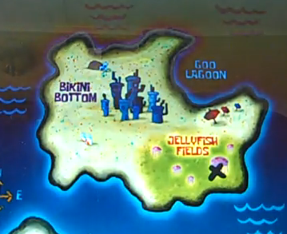
Cell wall
> The analogy of the cell wall would be the Goo Lagoon because it protect the Bikini Bottom.

Slide 3
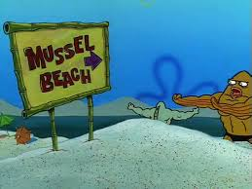
Cell Membrane
The beach in spongebob is like a cell membrane because it is inside of the cell wall in this case it’s the goo lagoon.

Slide 4
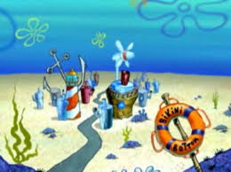
Nucleus
The nucleus is like the bikini bottom in SpongeBob because it is the center.

Slide 5
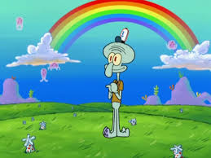
Golgi Body
The jellyfish are like the Golgi body because there are organized and they make jelly.

Slide 6
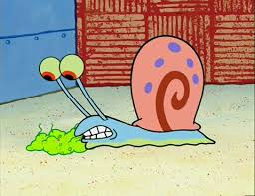
Lysosome
Gary is like a lysosome because he is a bottom feeder who eats bacteria.

Slide 7
Cytoskeleton
The Krusty Krab is like a cytoskeleton because it keeps everyone healthy and alive.

Slide 8
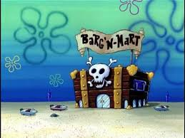
Vacuole
The barg’ n-mart is like a vacuole because it has many different things stored in it

Slide 9
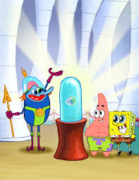
Cytoplasm
> Atlantis contains the oldest bubble and that is the most important thing to a lot of people just like cytoplasm is important to cells.

Slide 10
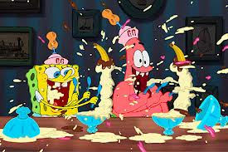
Mitochondria
In SpongeBob when he eats ice cream it makes him full of energy like in the SpongeBob movie its just like a mitochondria.

Slide 11
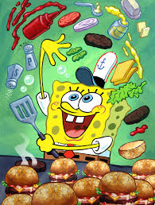
Ribosomes
Spongebob is like a ribosome because he makes krabby patty.

Slide 12
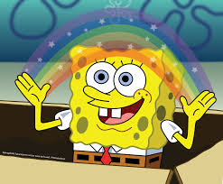
THE END!!!!!!! ☺

