Slide 1
Cell Analogy Analogy to a School
Mia Murray & Taylor Haney

Slide 2
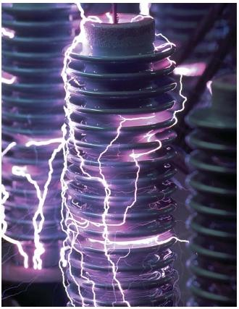
Cytoplasm
The cytoplasm circulates materials through the cell
Analogy: Electricity circulates and flows through the building

Slide 3
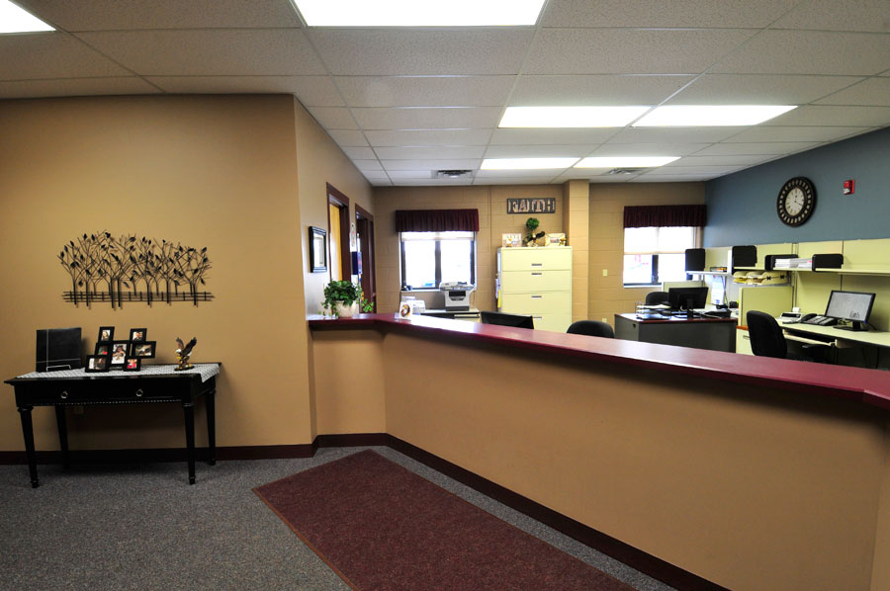
Nucleus
The nucleus controls all cell activity
Analogy: Office controls what goes on through the entire school

Slide 4
Nucleolus
Inside of the nucleus
Analogy: Principal is inside of the office (nucleus)

Slide 5
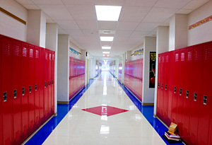
Endoplasmic Reticulum
The ER has materials and proteins that travel through it
Analogy: Hallways allow students and staff to travel

Slide 6
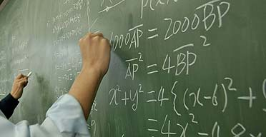
Ribosome
The ribosome produces things, energy, and materials
Analogy: Students produce work, projects, homework

Slide 7
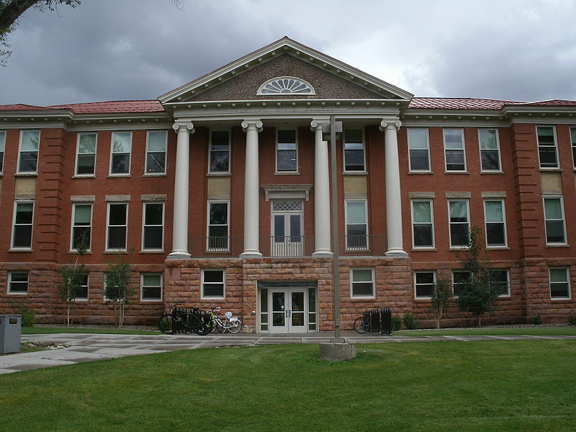
Cell Wall
The cell wall provides structure and shape for the cell, prevents from bursting when water enters
Analogy: School building is the general structure prevents things from coming in (bad) and protects the inside

Slide 8
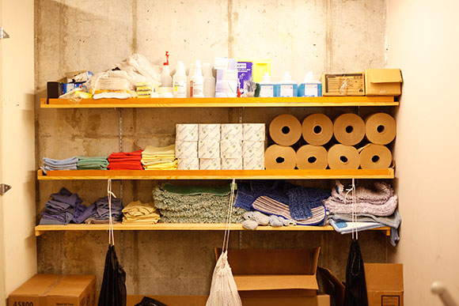
Vacuole
Vacuole stores water and substances for the cell
Analogy: Custodians closet stores materials for the building

Slide 9
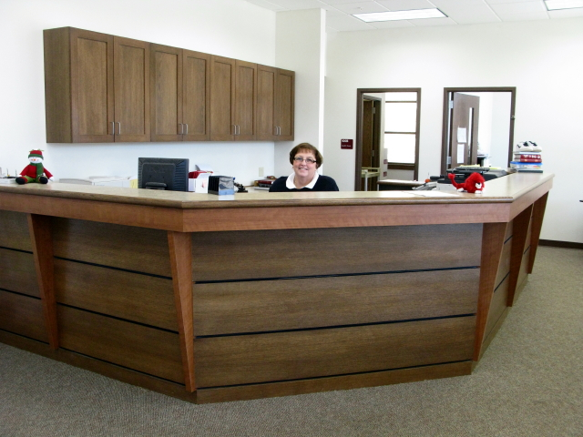
Golgi Body
The Golgi body packages, modifies and sorts materials in the cell
Analogy: Secretary does the same thing (sends students out, dismissal..)

Slide 10
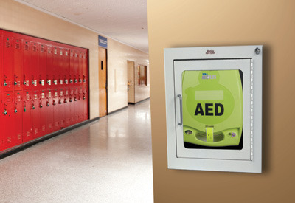
Cell Membrane
The Cell Membrane is inside of the cell wall and it allows things in and out
Analogy: Walls inside of the school provide an extra layer and allows people in and out

Slide 11
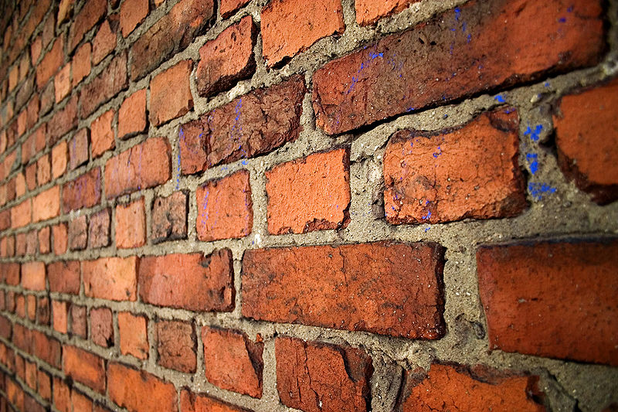
Cytoskeleton
The Cytoskeleton supports cell
Analogy: Bricks (wall structure) and cement throughout the walls are what keeps the building structure in place as a foundation

