Slide 1
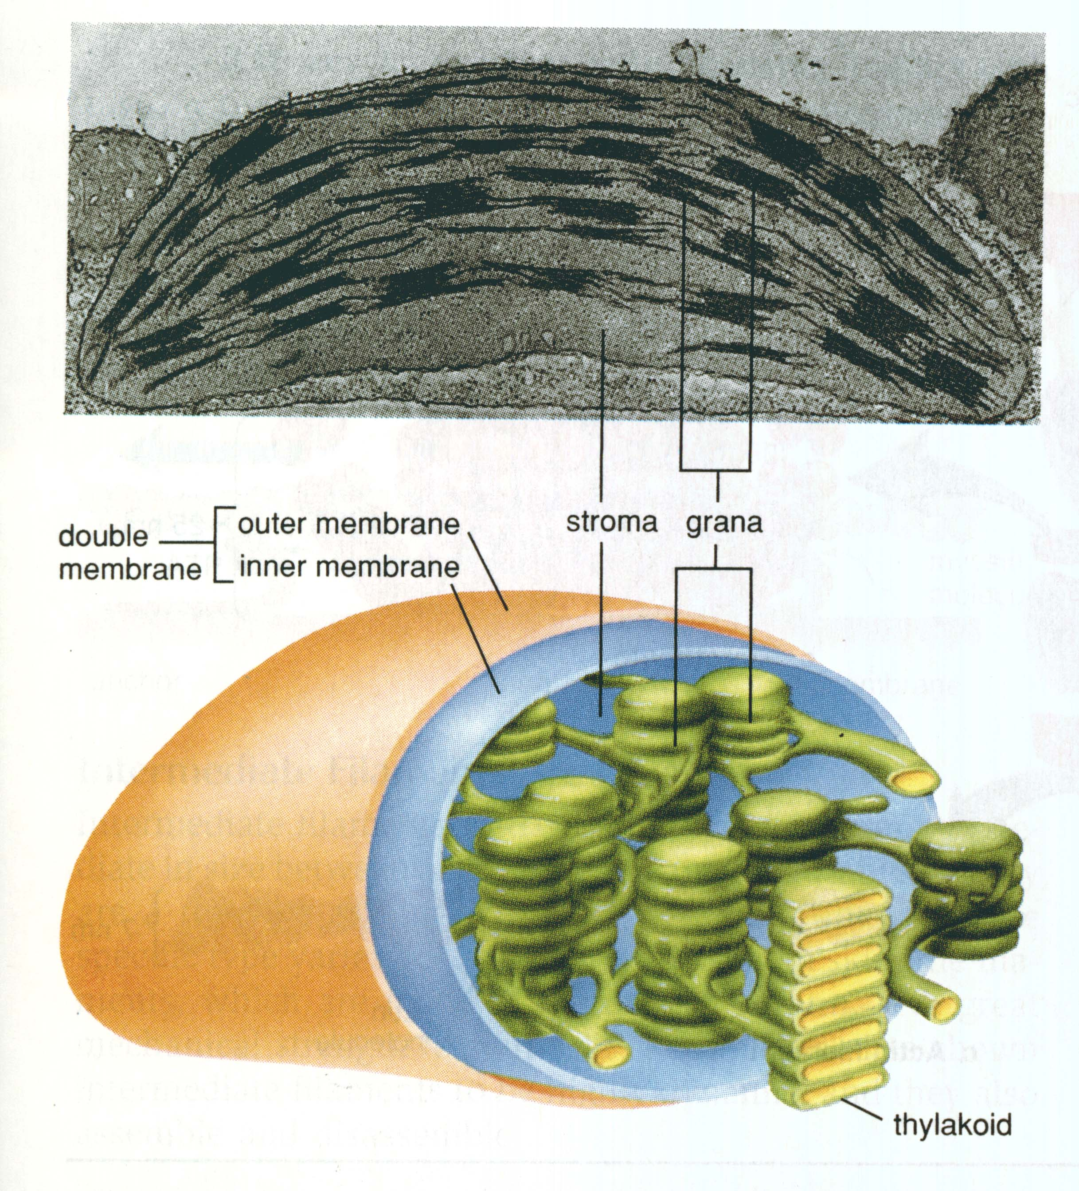
Chloroplasts

Slide 2
Chloroplasts
Composed of stacks of green disks called grana.
Each disk is made of a thylakoid membrane; light reactions take place here.
Stroma is the space around the grana where the dark reactions take place

Slide 3
Factors that Affect Plant Growth
All plants require the following factors, but the amount or level depends on the particular type of plant.
1. Light: Green wavelengths of light are reflected by chlorophyll(pigment in chloroplasts) and cannot be used for photosynthesis.
Blue and Red wavelengths of light are readily
absorbed by chlorophyll and optimal for
photosynthesis

Slide 4
2. Temperature:
optimal temperature range for most plants is 0º-40ºC
3. pH:
optimal pH range for most plants is 5.5 and 7.0
4. Water
5. Nutrients:
include nitrogen(N), phosphorus(P), and sulfur(S)

