Slide 1
Organisms and Energy

Slide 2
Photosynthesis
Reactants: Carbon Dioxide and Water
Products: Glucose(sugar) and Oxygen
Energy: powered by energy from the sun

Slide 3
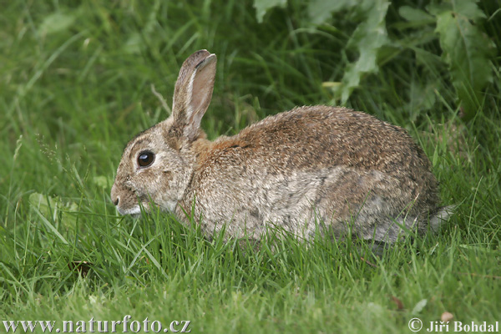
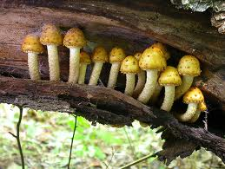
How do organisms obtain their food?
Autotrophs: make their own food, usually through photosynthesis
Heterotrophs: eat other organisms
utotro

Slide 4
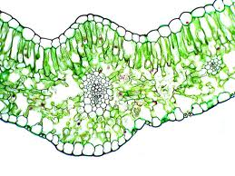
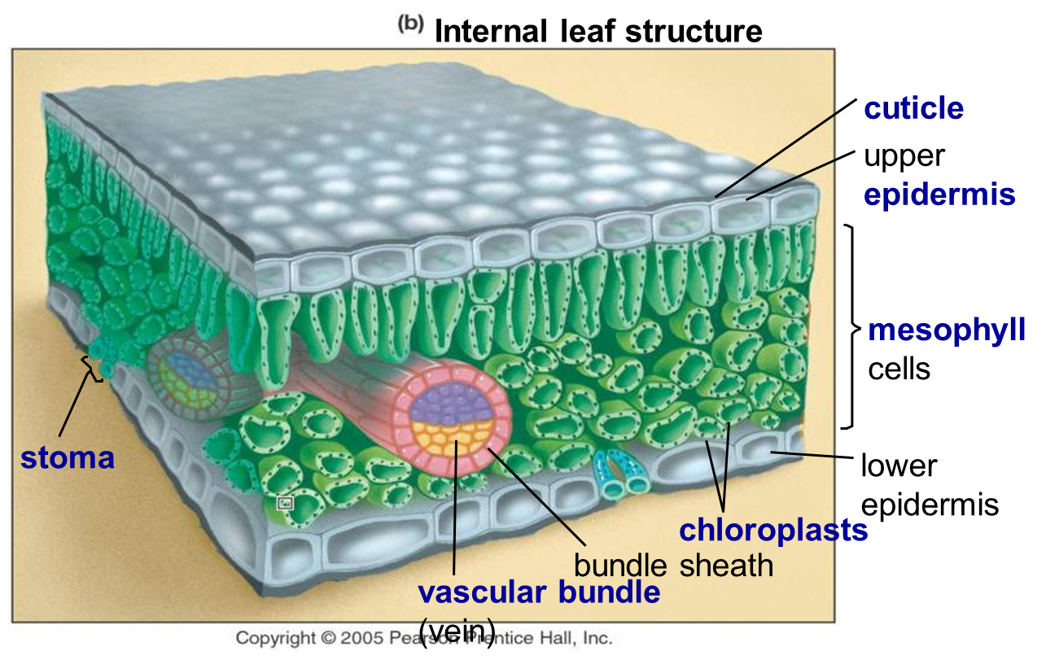
Where Photosynthesis Takes Place

Slide 5
Leaves
Specialized photosynthetic tissue called mesophyll contains many chloroplasts.
Leaves are specialized for photosynthesis:
Found at tops of plants
Very thin
Waxy cuticle to prevent water loss

