Slide 1
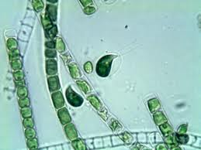
Organization In Living Things

Slide 2
Unicellular Vs. Multicellular Organisms
Unicellular
Multicellular
Simple organisms composed of single cells.
Can be prokaryotes or eukaryotes
Can be autotrophs or heterotrophs
Examples: paramecium, bacteria, algae
Complex
Organisms composed of many cells
Only eukaryotes
Can be autotrophs or heterotrophs
Examples: trees, frogs, mushrooms

Slide 3
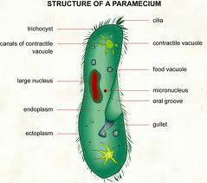
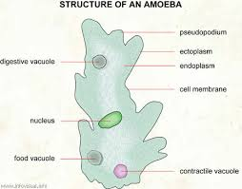
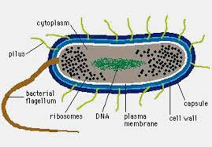
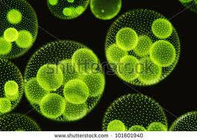
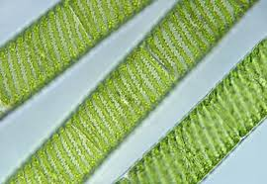
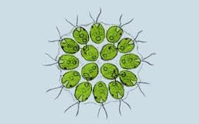
Unicellular Organisms

Slide 4
Unicellular Organisms
Cells must perform ALL functions
2. Some form colonies of many cells
3. Often have special structures for movement
and obtaining food
Cilia: many short “hairlike” structures on cell
surface
Flagella: 1 or 2 long “whip like” structures on cell
surface

Slide 5
Multicellular Organisms
Animals
Plants

Slide 6
Multicellular Organisms
Cells specialize to perform specific functions for the organism.
Examples:
Plants: leaf tissue contains many chloroplasts
for photosynthesis, roots are adapted to
absorb water and minerals
Animals: muscle cells contain many
mitochondria for producing lots of ATP for
movement

Slide 8
Levels of Organization
Cells: basic units of life which perform specific functions
Tissues: groups of cells performing the same function
Organs: groups of tissues working together
Organ Systems: groups of organs working together
Organism: many organ systems working together

