Slide 1
Cell Organelle: Analogy To A Football Team
How are Organelle and analogous parts similar?
Example today: The New England Patriots!

Slide 2
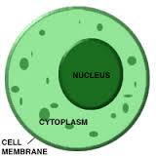
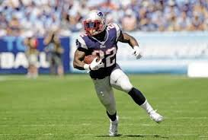
Cytoplasm
Cytoplasm Cushions the inside of the cell.
Just like the cytoplasm cushioning the inside of the cell your running back provides cushion that you should always be able to rely on your running back.

Slide 3
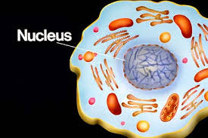
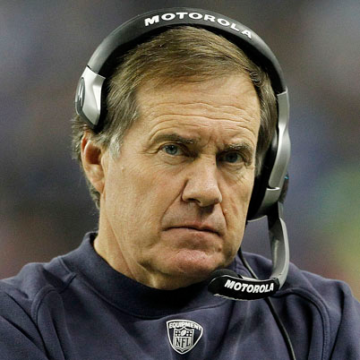
Nucleus
The nucleus contols the whole cell
Just like the nucleus the head coach controls the whole team

Slide 4
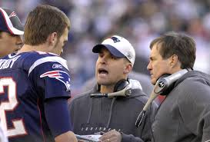
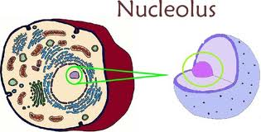
Nucleolus
the nucleolus helps the nuclelous control the cell
The head coaches help the coach contole the team

Slide 5
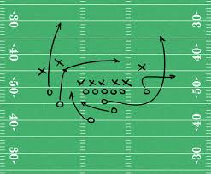
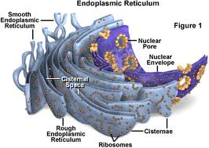
Endoplasmic reticulum
This helps the cell stay aliove with trancpertantion/structure
The plays help the partiots win games

Slide 6
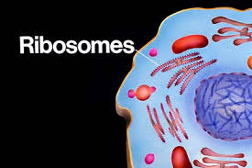
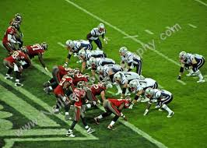
Ribosomes
They are a bunch of particals assembles to make a whole
The offence is a bunch of different parts working together as a whole

Slide 7
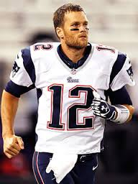
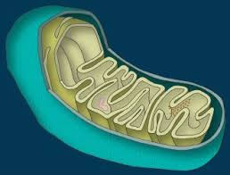
Mitochondria
This provides energy
A quarterback is supposed to provide energy for his team

Slide 8
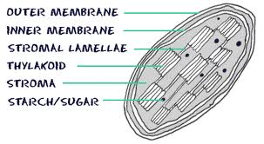
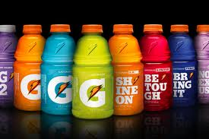
Chloroplast
This fills the cell
Gatorade fills the players

Slide 9
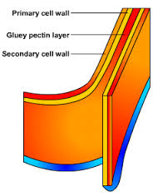
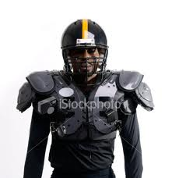
Cell Wall
Provides protection
Pads provide protection for all football players

Slide 10
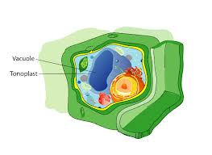
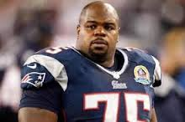
Vacuole
Supports heavier structures
Team captain provide team with positive support all the time

