Slide 1
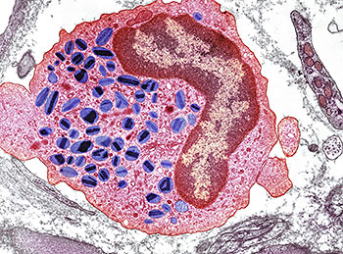
Eukaryotic Cell Organelles

Slide 2
Cell Wall Plants
Structure:
-surrounds cell membrane of
plant cells
Function:
-provides structure & shape for
plants
-protects cells

Slide 3
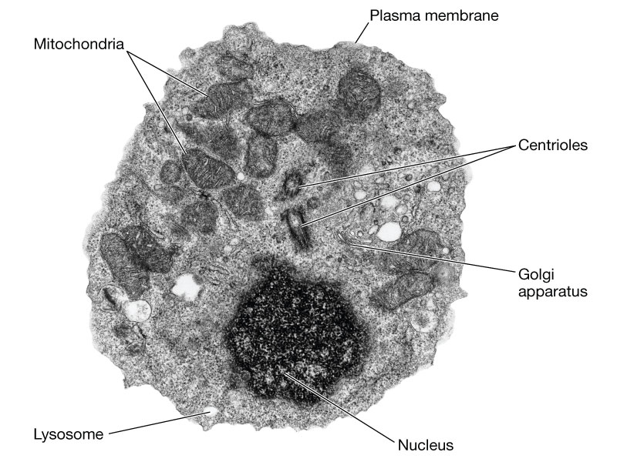
Cell Membrane Plants & Animals
Structure:
-surrounds cell contents
Function:
-protects the interior of cell
from the environment
-provides structure for the cell
-allows for the passage of
materials into and out of
the cell

Slide 4
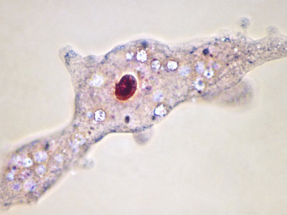
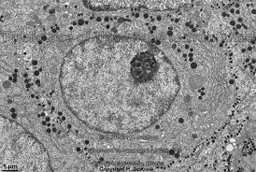
Nucleus Plants & Animals
Structure:
-contains most of the cell’s genetic
material(DNA)
Function:
-controls all cell activities (growth &
reproduction)
-produces RNA and ribosomes

Slide 5
Cytoplasm Plants & Animals
Structure:
-is found between the cell mem-
brane and nucleus
-contains all cell organelles
-composed mostly of water with
many dissolved substances
Function:
-provides support to structures
in cell
-allows materials to move
around the cell

Slide 6
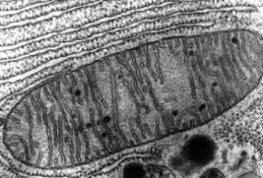
Mitochondria
Structure:
- membrane bound structure
-”bean” shaped
Function:
-site of cellular respiration,
where food is broken down to
produce ATP (energy for the
cell)

Slide 7
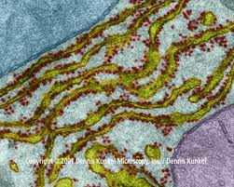
Endoplasmic Reticulum Plants & Animals
Structure:
-series of membranes through
out the cell
Function:
-proteins produced by ribosomes
are transported directly into ER

Slide 8
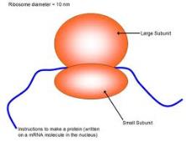
Ribosomes Plants & Animals
Structure:
-small particles found attached to the
nucleus or ER or floating in the
cytoplasm
Function:
-site of protein synthesis

Slide 9
Vacuole Plants(large) & Animals(small)
Structure:
-membrane bound structure
-large central vacuoles found in
plant cells
Function:
-storage for various substances
(water, wastes, and food)

Slide 10
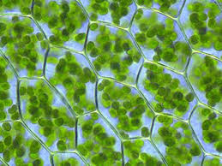
Chloroplast Plants
Structure:
-contains chlorophyll, which give them
their green color
Function:
-site of photosynthesis(food pro-
duction) in plants and algae

