Slide 1
A cell to a football team
Project by: Nate Hann
Exaples from: the Green Bay Packers

Slide 2
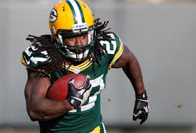
Cytoplasm
The cytoplasm provides support to the nucleus
I said that the Packers running back Eddie Lacy is a good example because he provides support with the run game when the team doesn’t know what else to do

Slide 3
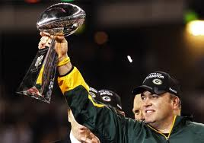
Nucleus
The nucleus contains the cell’s genetic material and controls all cell activities.
I think the Mike Mccarthy, the Head coach of the Packers is a example of a nucleus because he controls all offence and defence of the team

Slide 4
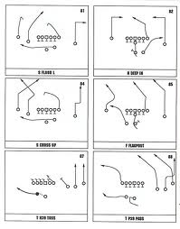
Endoplasmic Reticulum
The endoplasmic reticulum produces protiens just like the plays will produce ways to win the game

Slide 5
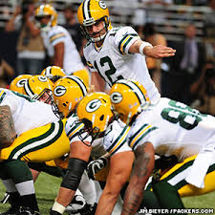
Ribosome
The ribosome is comparied to the offence of the team because they are very close to the coach (nucleus) and they work as a whole

Slide 6
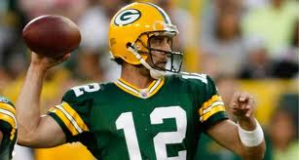
Mitochondria
I am comparing the Mitochondria to Aaron Rodgers (the quarterback) because he provides energy and pumps up the team

Slide 7
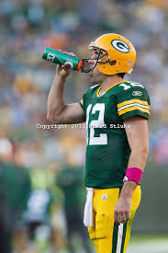
chloroplast
I think that gatorade is the best example of chloroplast because gatorade refills you like chloroplast refills the cell

Slide 8
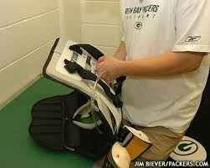
Cell wall
Pads protect all football players on the packers team like the cell wall protects the cell

Slide 9
vacuole
This symbol is a symbol of a captian of the packers football team I think a vacuole compares to a football team because the captian supports the team like a vacuole supports heaver structures in the cell

Slide 10
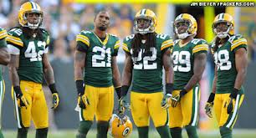
lysosome
These are the packers defencive backs, they break down plays and react acordigly just like the lysosomes break down lipids

