Slide 1
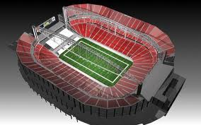
Football Stadium

Slide 2
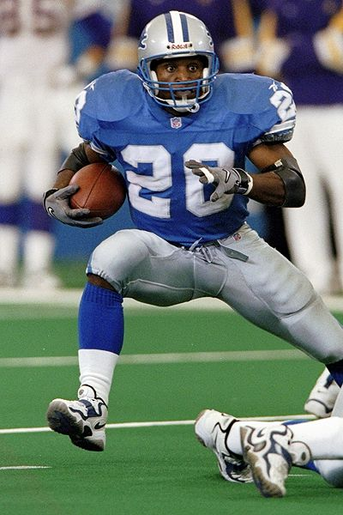
Ribosome
Because they score.
Produce the points.

Slide 3
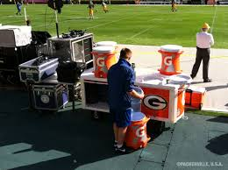
Mitochondria
Produces the energy
Football players drink Gatorade to give them energy to play

Slide 4
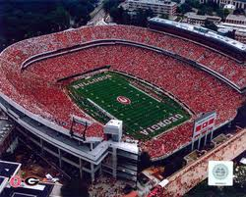
Cell Wall
Outer fence

Slide 5
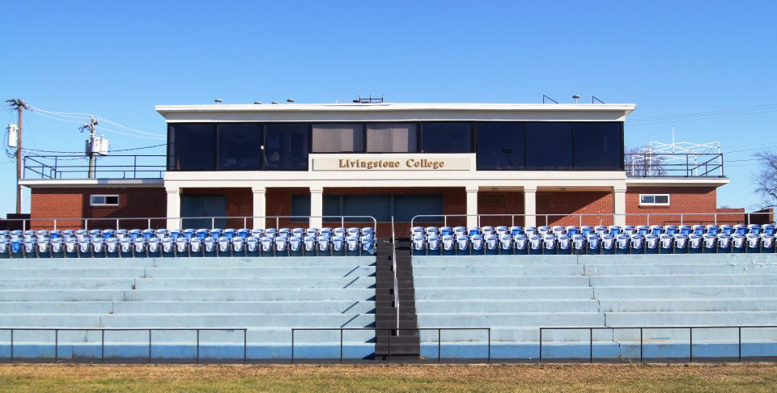
Nucleus
The Nucleus of a football field is the Press box

Slide 6
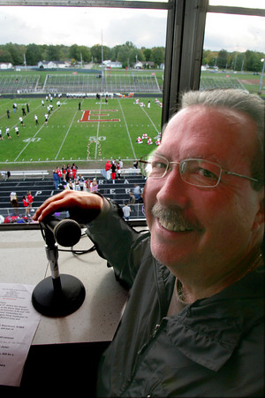
Nucleolus
The Nucleolus is the announcer

Slide 7
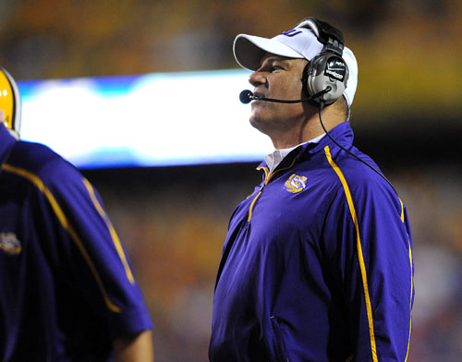
Endoplasmic Reticulum
The headset is the is the Endoplasmic Reticulum because that’s how information is transported

Slide 8
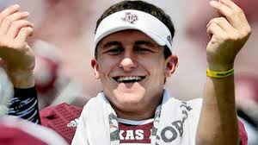
Lysosome
The trash can represents lysosome because they throw waste in it

Slide 9
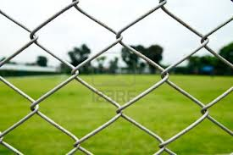
Cell Membrane
Inner fence is the cell membrane because it’s the cell wall.

Slide 10
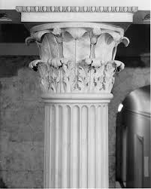
Cytoplasm
Provides structure

Slide 11
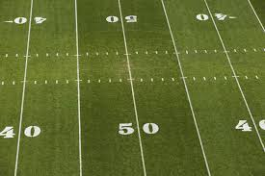
Chloroplast
The grass the players play on is green
in green plant cells a plastid that contains chlorophyll and in which photosynthesis takes place

