Slide 1
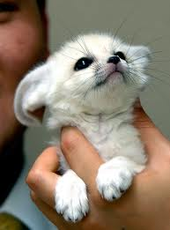
Facebook
Wall
Photos
Name
Logout
Name
Wall
Info
Photos
Information
Current City: Sahara Desert
Hometown: North Africa
Sex: Female
Birthday: November 2, 2000
Relationship Status: Married to fennec fox
Employer: Stay at home wife
Education: None
Religion: None
Political Views: None
People Who Inspire: Papa and Mama
Favorite Quotations:
Favorite Books:
Activities:
Wall
Info
Photos
Friends
Contact Information
Address: Street, City, State, Zip Code

Slide 2
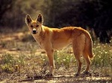
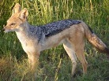
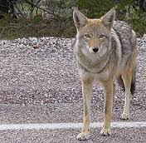
Facebook
Wall
Photos
Name
Logout
Fennec Fox
Fennec Fox Can’t wait until tonight . I’m famished >.<
11.14.13 Like · Comment · See Friendship
Friends
Fennec Fox Our neighbor got a liter of her own pups earlierXD
11.13.12 Like· Comment · See Friendship
Dingo
Fennec Fox I’ve never had to run so fast in my whole life before
11.12.13Like · Comment · See Friendship
Jackal
Jackal Just wait until next time little buddy
Coyote
Fennec Fox No gracias
Fennec Fox Had fun chasing down my dinner
11.11.13 · Comment · See Friendship

Slide 3
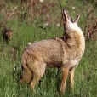
Facebook
Wall
Photos
Name
Logout
Fennec Fox
Jackal Almost had him too >.<
June 2, 2013 Like · Comment · See Friendship
Friends
Coyote u’ll get him next time
Dingo Escaped another of them bad people again.
June 1, 2013 Like · Comment · See Friendship
Coyote Just waiting for the sun to go down because I am starving
May 15, 2013 Like · Comment · See Friendship
Jackal Same here man!

Slide 4
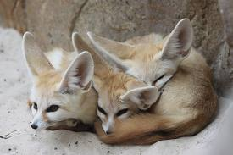
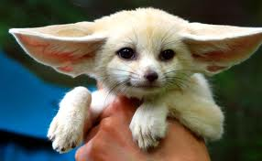
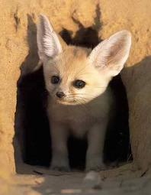
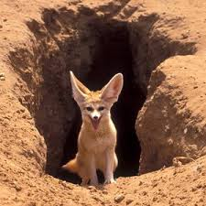
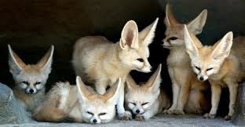
Facebook
Wall
Photos
Name
Logout
Fennec Fox
Wall
Info
Photos
Photos of Name 6 Photos

