Slide 1
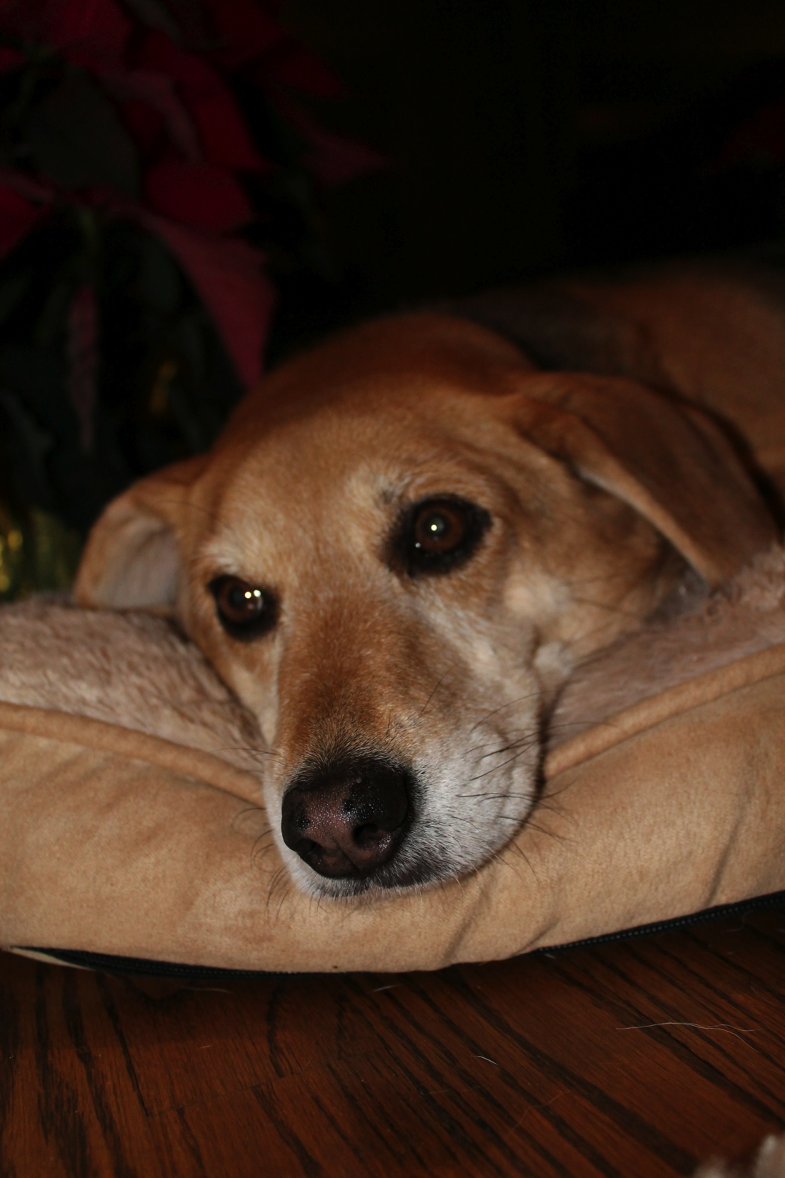
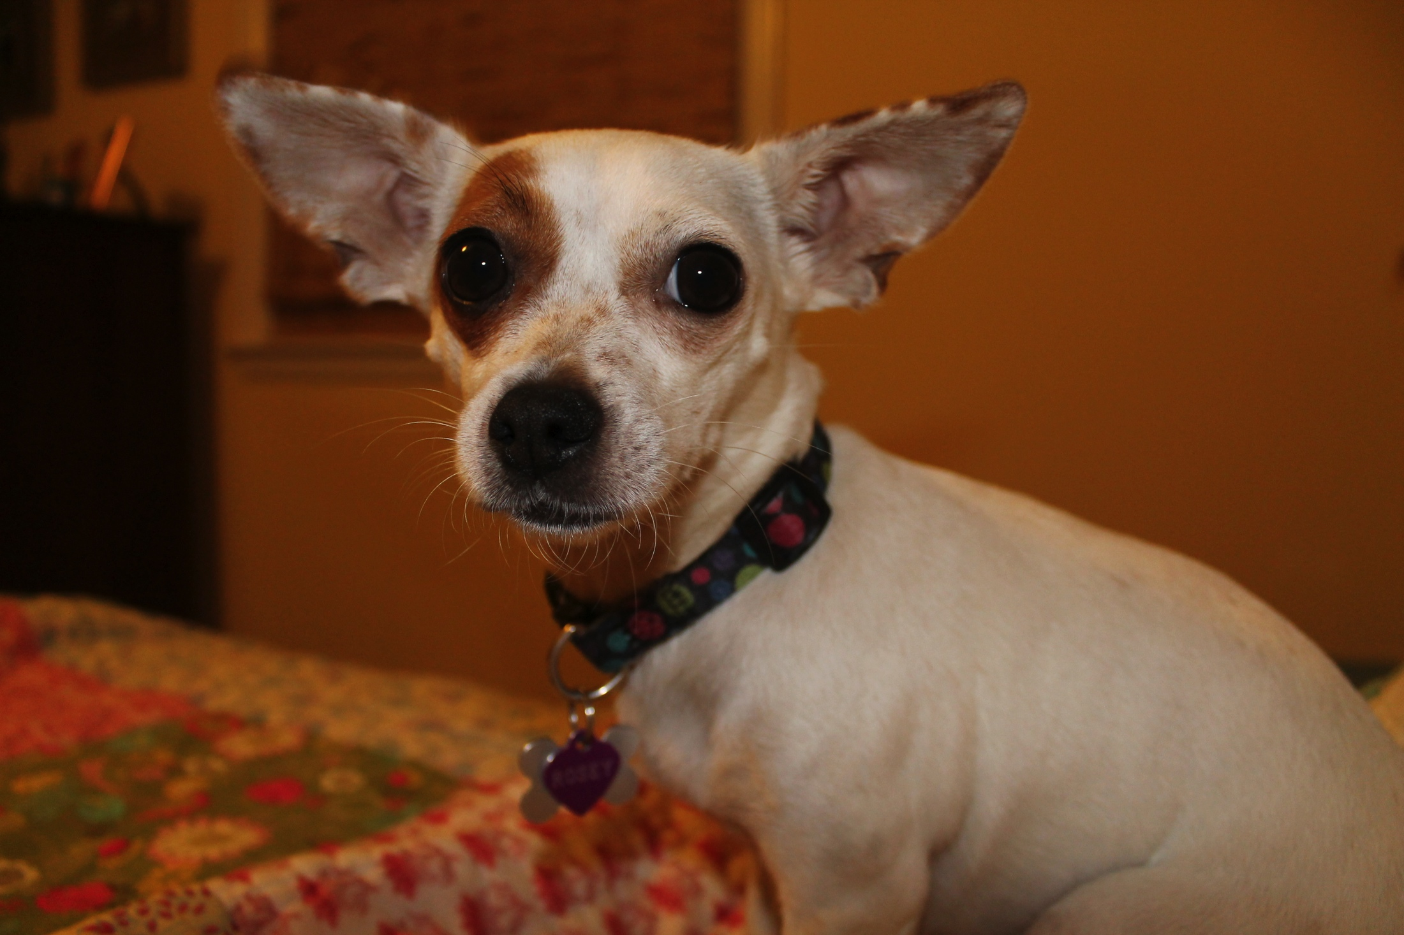
My Family
My Family
Tim and me
Emily & Elizabeth
Rosey
Claire

Slide 2
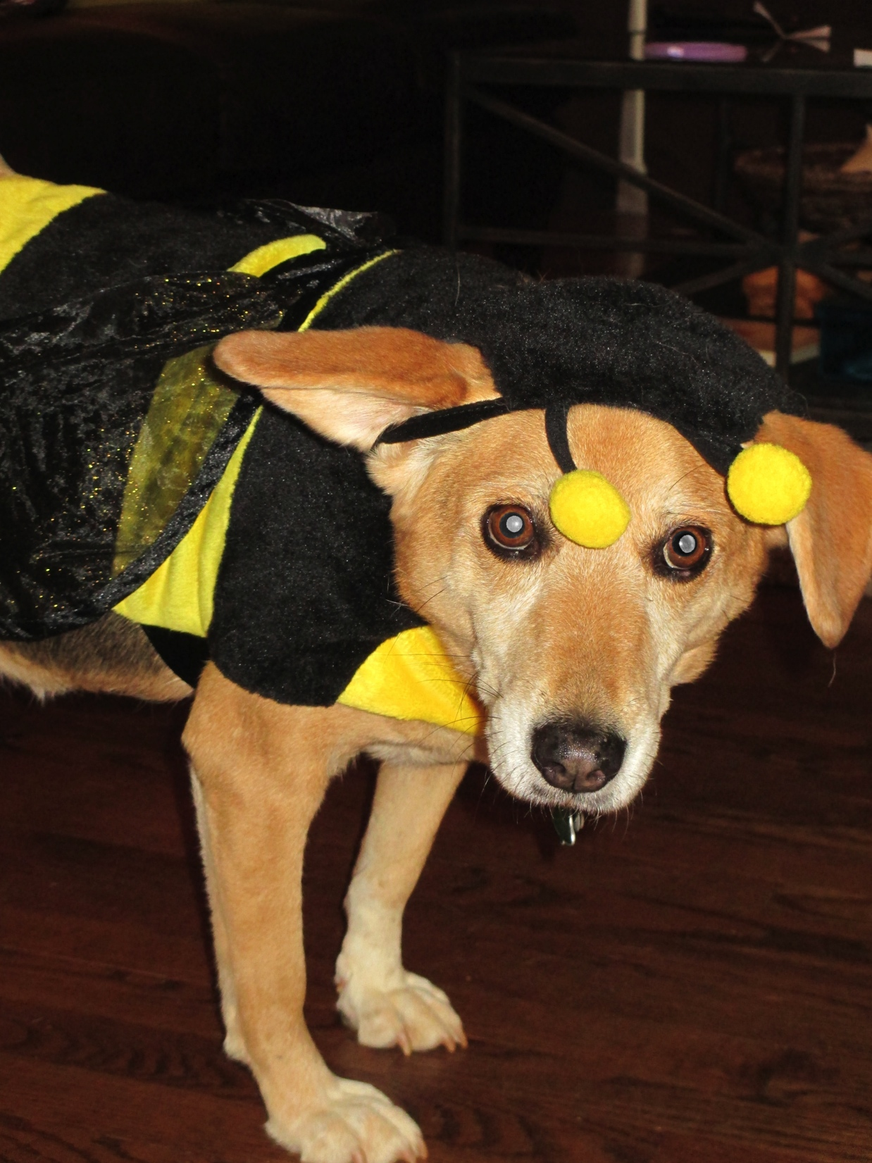
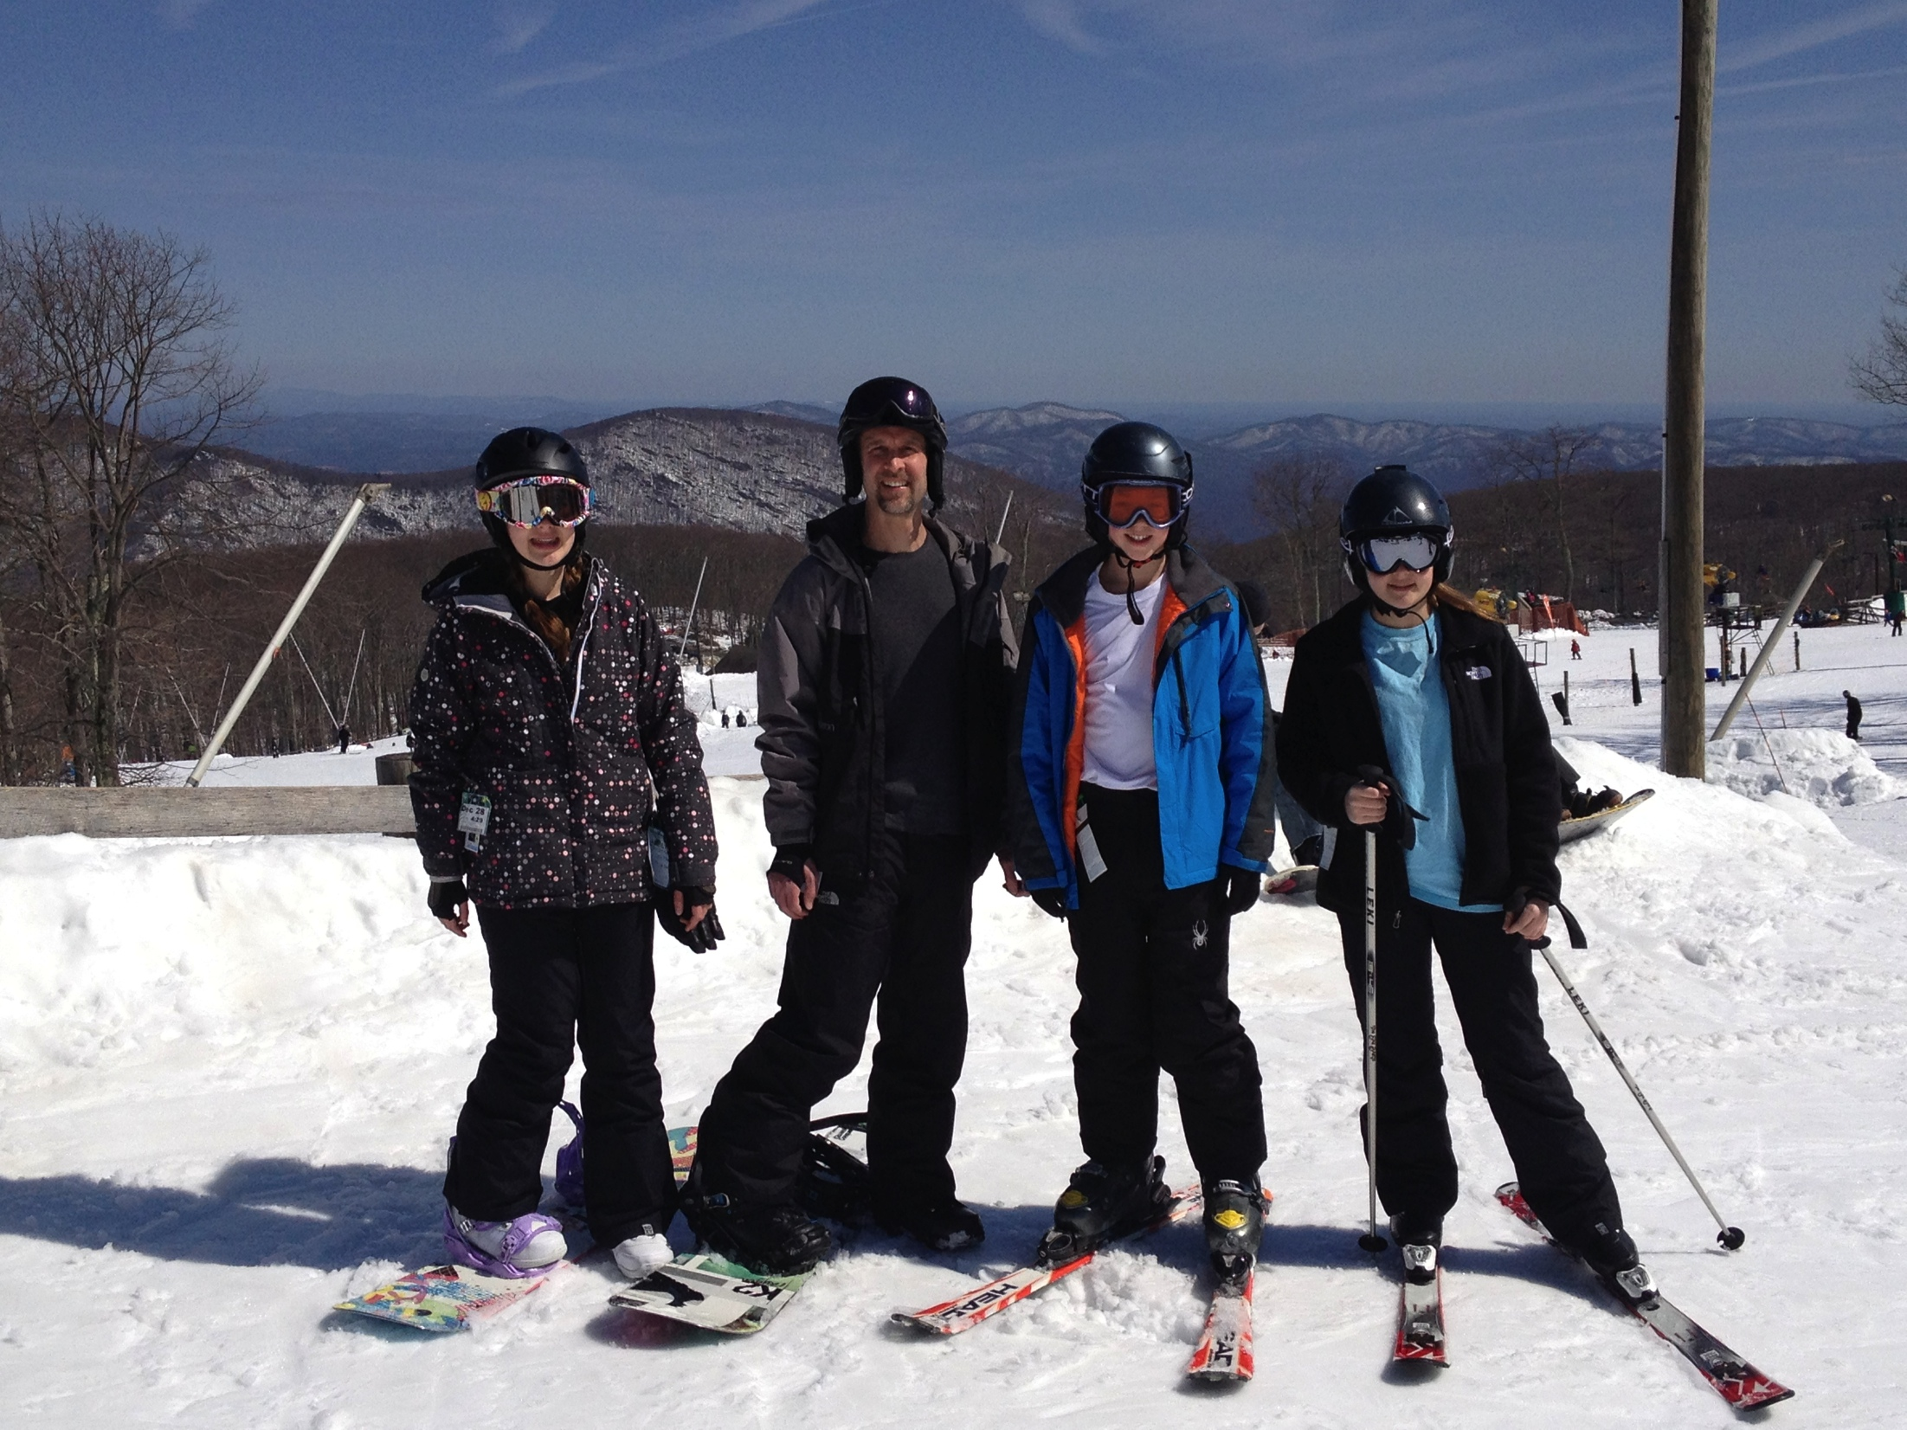
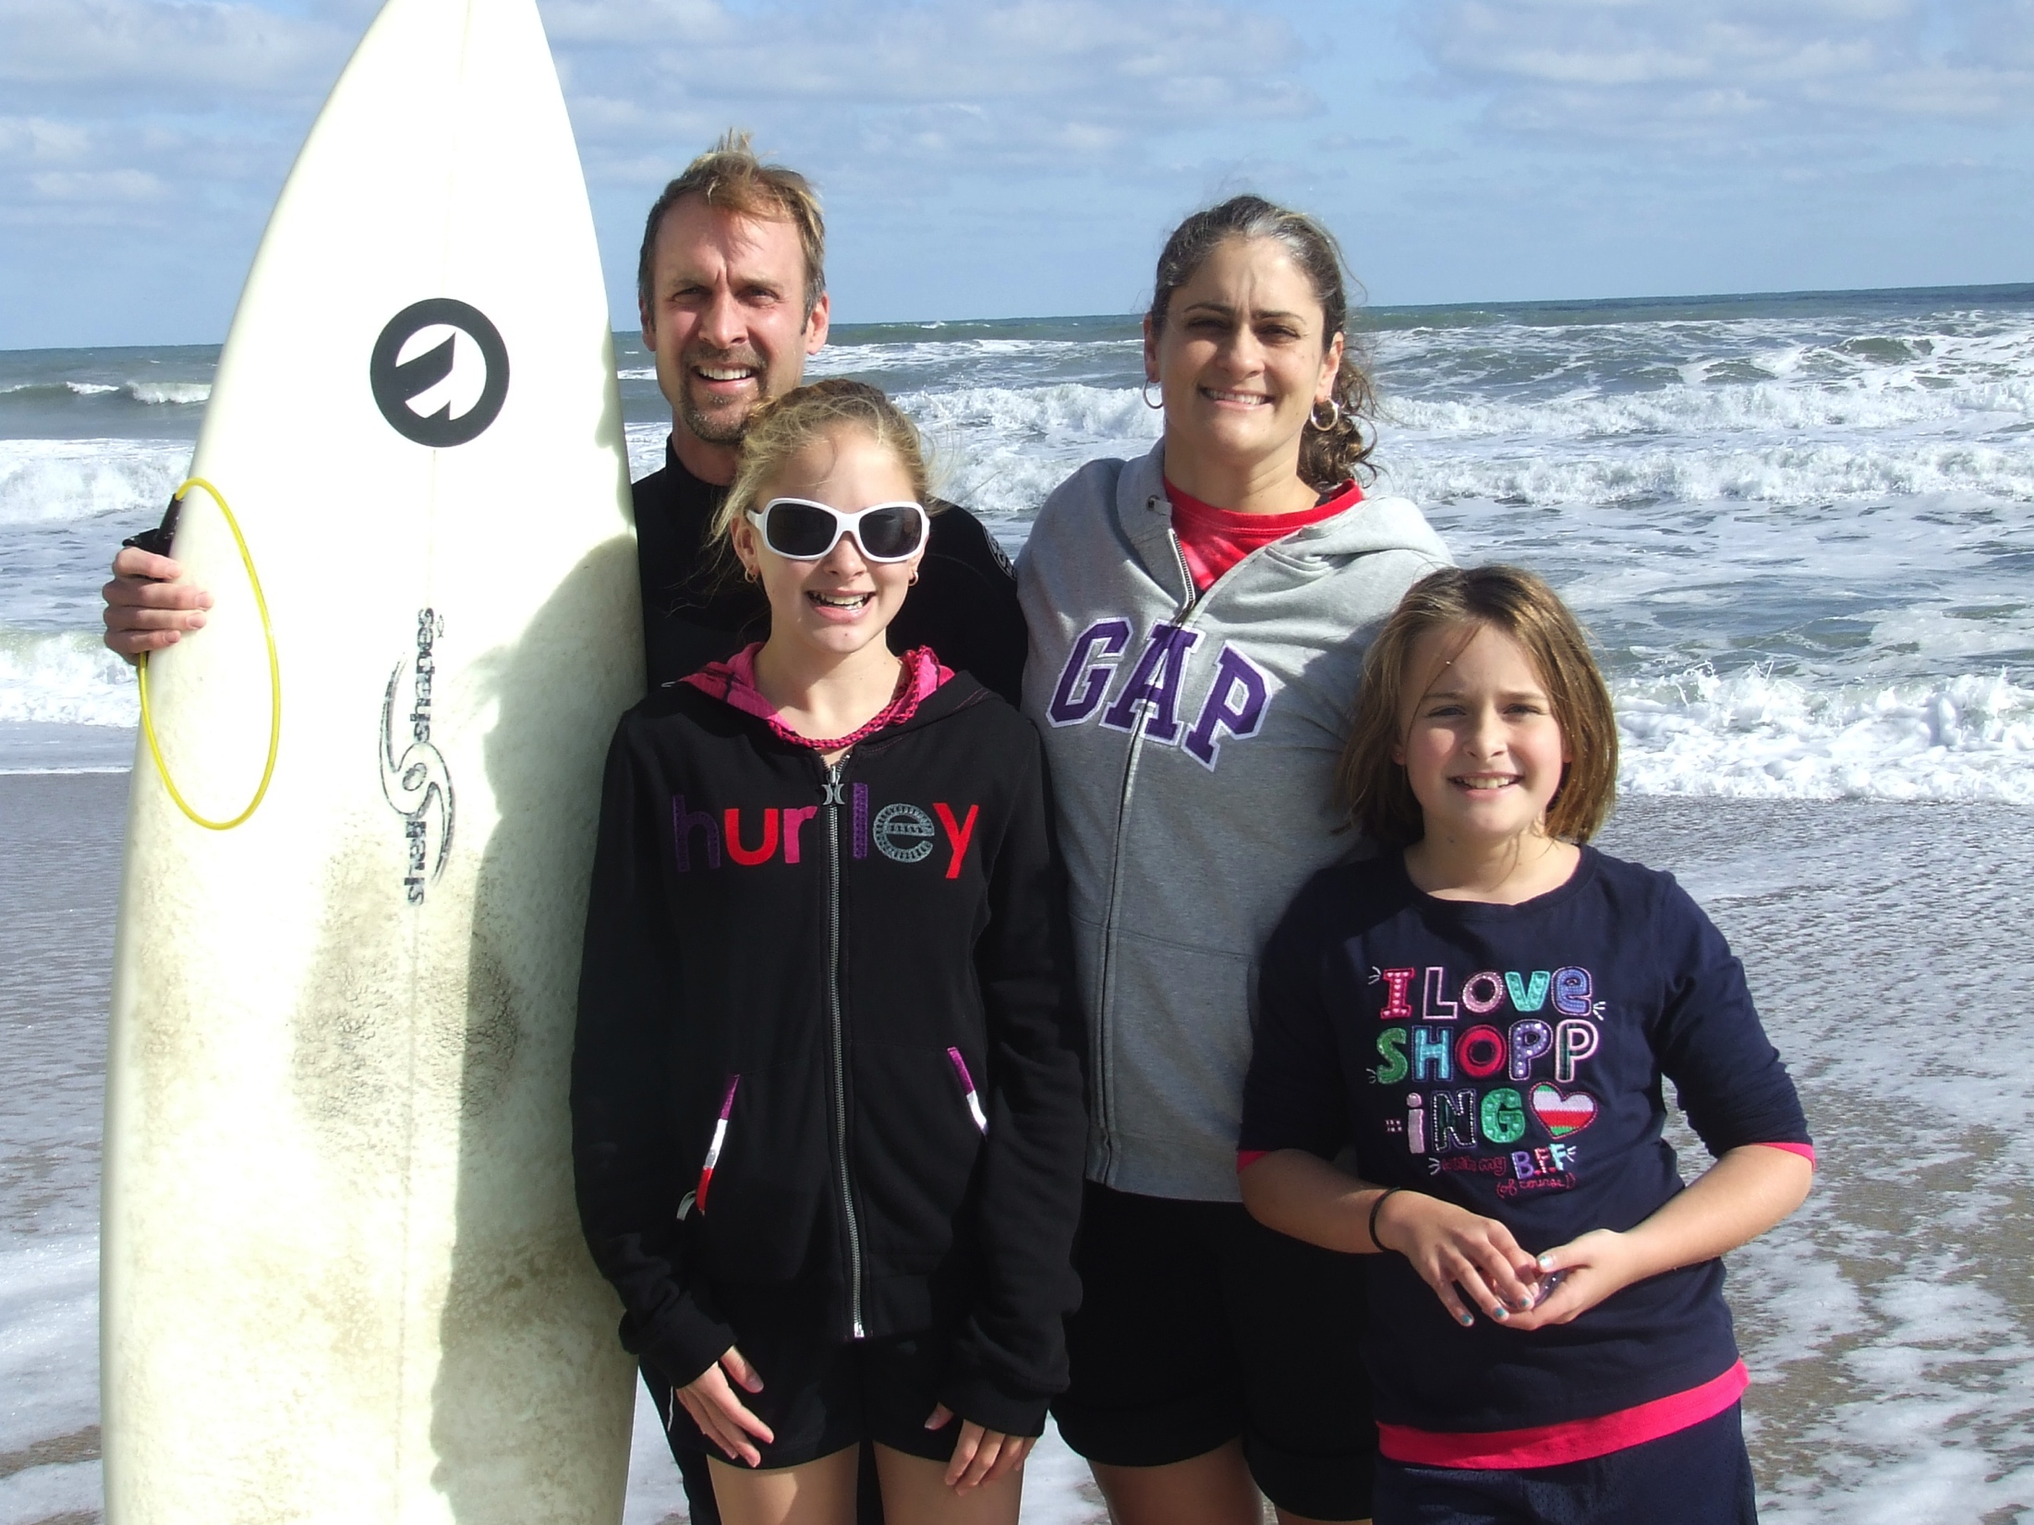
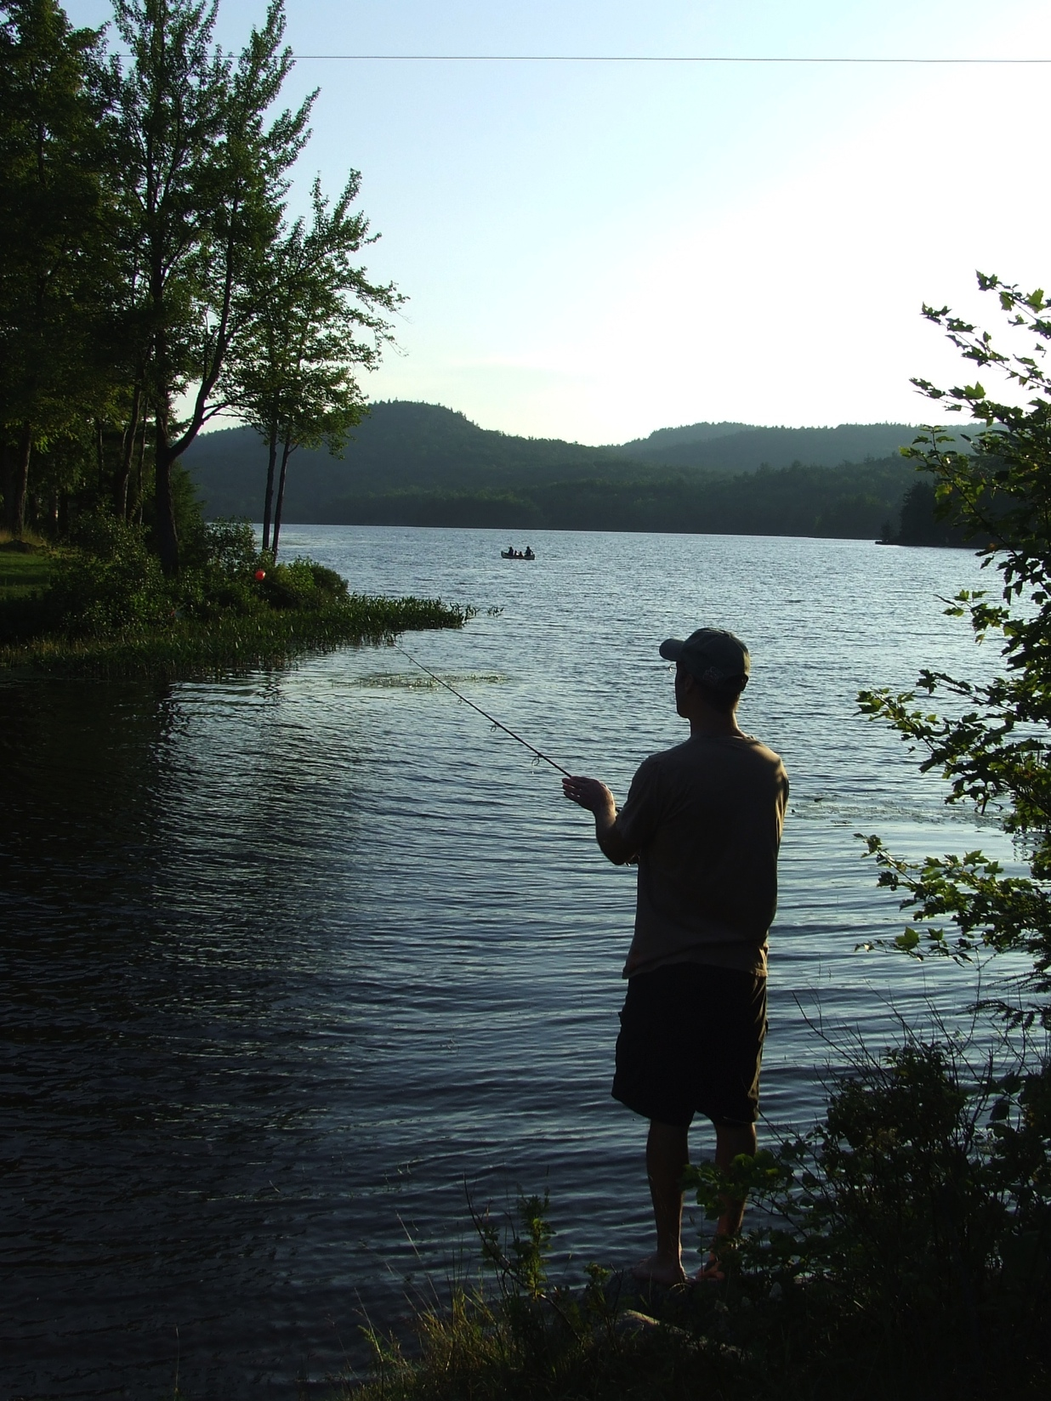
Some of The Things We Like To Do
Go to the beach
Dress up for Halloween
Skji and Snowboard
Run
Camp, fish, and hike

