Slide 1
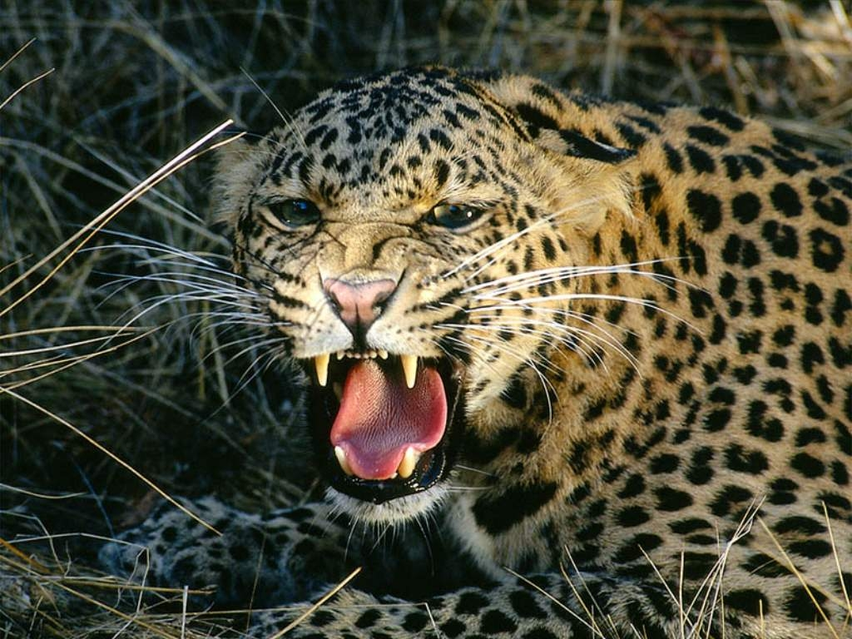
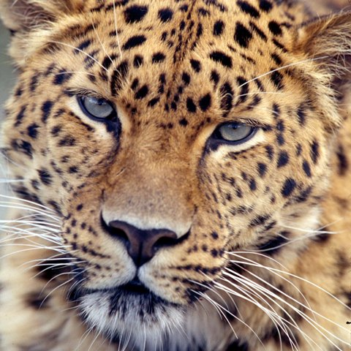
facebook
Wall
Photos
Name
Logout
Name
Wall
Info
Photos
Information
Wall
Info
Photos
Friends
Contact Information
Address: 90000 Downy Tree, Tabla, South Africa , 290087

Slide 2
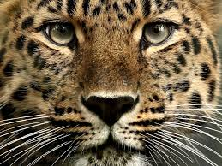
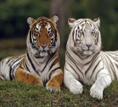
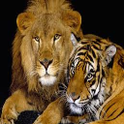
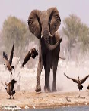
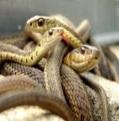
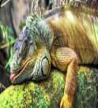
facebook
Wall
Photos
Name
Logout
Name
Wall
Info
Photos
Wall
Update status
Share
Just came back from hunting a big yummy snack! Next time I'm going for a big beat, a very juicy one ust
Info
Photos
Friends
Friends
Baby Cakes
Happy NewYears
01 01, 2011 Like · Comment · See Friendship
Friend’s name
Chubby Nose
Happy NewYEars
01 01, 2011Like · Comment · See Friendship
Leoparda
Same to you lets go kiill
Friend’s name
Mouse
Birthday coming up
12 20, 2010 Like · Comment · See Friendship
Friend’s name
Leoparda
How about a baby tiger as a gift
Away
☺)
12 14, 2010 Like · Comment · See Friendship

Slide 3
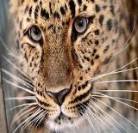
facebook
Wall
Photos
Name
Logout
Name
Friends
Jasmyn C
Milo
We need to move out
June 11, 2010 Like · Comment · See Friendship
Mouse
Stay off my pray
june 11, 2010 ike · Comment · See Friendship
Diana T
Diana T
june 10, 2010 Like · Comment · See Friendship
Elai A
Leopard
Lets chill Yo!!!!!!!
Diana T
When ????
Tango
I’ll see you than
june 09, 2010 rLike · Comment · See Friendship

Slide 4
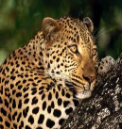
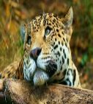
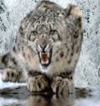
facebook
Wall
Photos
Name
Logout
Name
Friends
Diana T
Heyyyyy☺
November 29, 2009 Like · Comment · See Friendship
Leoparda
Hey whats up (:
comment
Elai A
☺
November 12, 2009Like · Comment · See Friendship
Melanie C
Hey, so guess what? Shay doesn’t like me!
November 20, 2009Like · Comment · See Friendship
Leoparda
We know just kill her!!!!

Slide 5
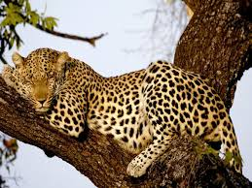
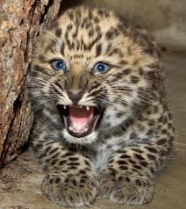
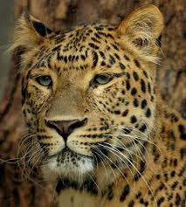
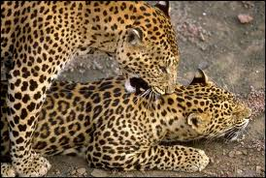
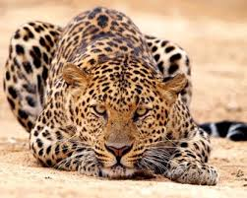
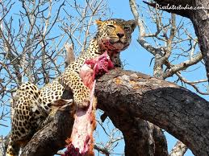
facebook
Wall
Photos
Name
Logout
Name
Wall
Info
Photos
Photos of Name 6 Photos

