Slide 1
Cell organelles compared to Eve Online.
A space MMO game.
By Zach Pearson

Slide 2
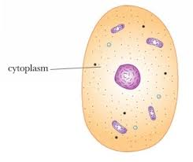
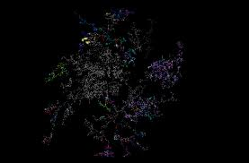
Cytoplasm
New Eden
Everything in a cell is in the cytoplasm
Everything in Eve online is based in New Eden

Slide 3
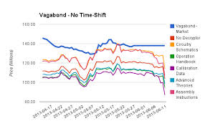
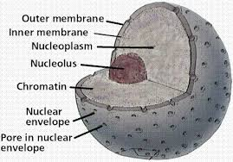
Nucleus
Jita
Where everything is controled
Where the market prices are based on.

Slide 4
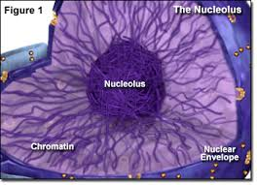
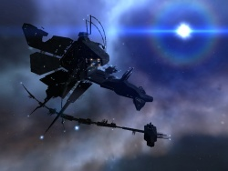
Nucleolus
Station in Jita
A part of the nucleolus
A part of jita

Slide 5
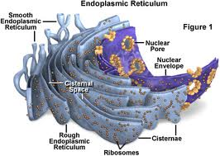
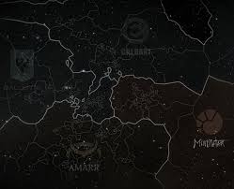
Endoplasmic Reticulum
The 4 Factions
Makes components of cell
Factions make ships, ship equipment and other things.

Slide 6
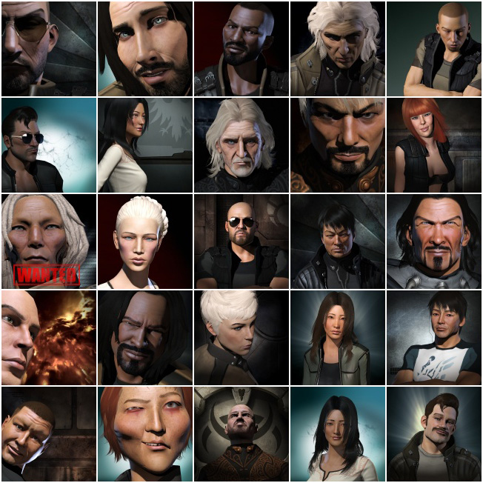
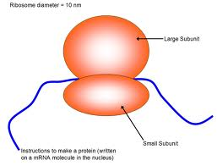
Ribosome
Characters
Makes Portions
Characters do most of the work in Eve online.

Slide 7
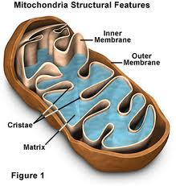
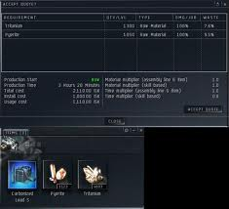
Mitochondria
Industry
Releases energy from food
People make ships and other things to fuel activity's in eve.

Slide 8
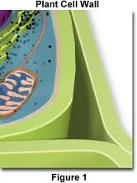
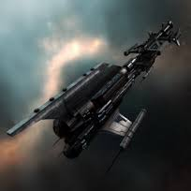
Cell wall
CONCORD
Keeps cell safe from viruses and other harmful things
Police force that keeps players safe in high security space.

Slide 9
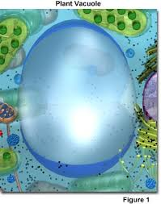
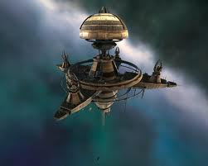
Vacuole
Station
Where liquid is stored in plant cells
Where players can store ships and there gear

Slide 10
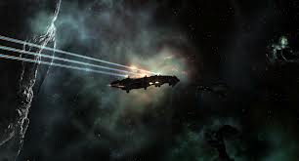
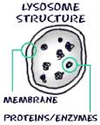
Lysosome
Miners
Breaks down food for energy
Miners get ore to be turned into ships and gear

Slide 11
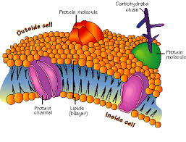
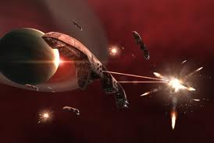
Cell membrane
Faction police
Weaker cell outer layer but still protects cell
Weaker police force that CONCORD but still strong

