Slide 1
Cell Organelle to Restaurant
By: Vincent O. and Juan G.

Slide 2
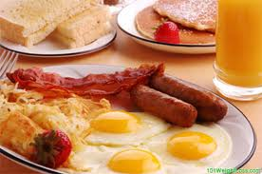
Cytoplasm to Food
Food provides proteins for the costumers.

Slide 3
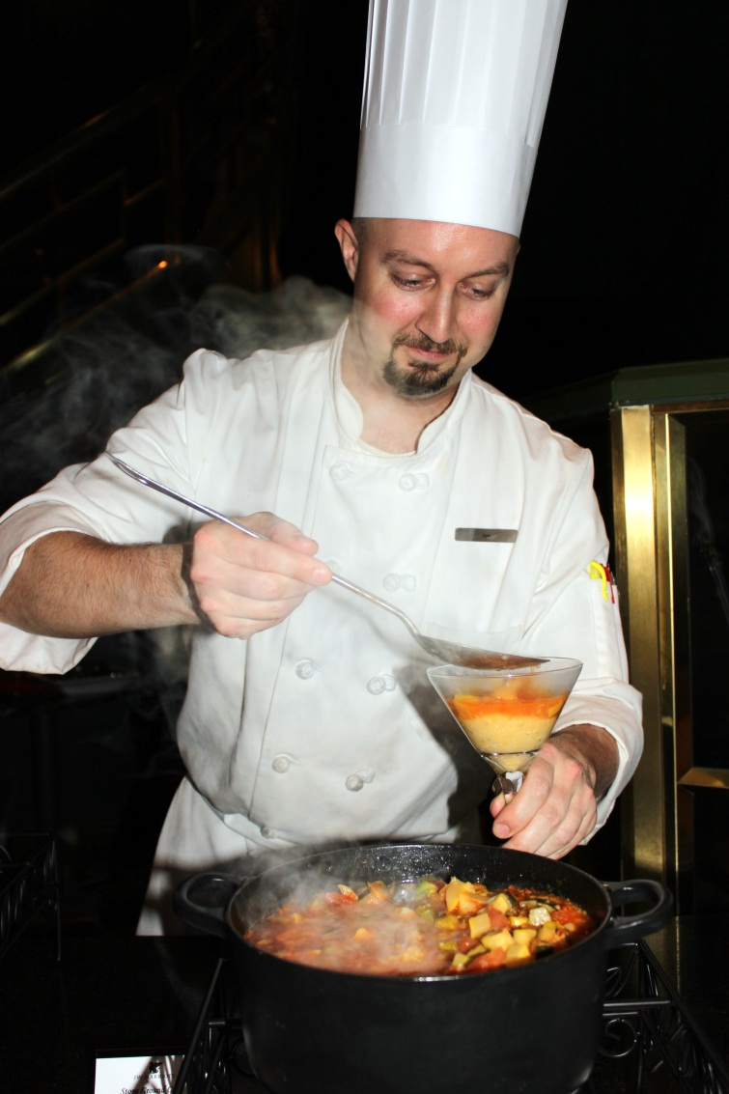
Nucleus to Chef
The chef goes around helping out and perfecting the dishes for presentation

Slide 4
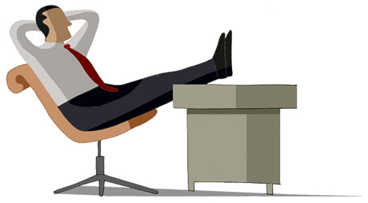
Nucleolus to Boss
Gives orders on what to do and controls what goes on.

Slide 5
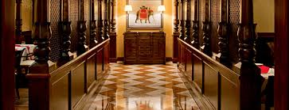
Endoplasmic Reticulum to Hallways
Food made by the workers and transported directly to the hallways.

Slide 6
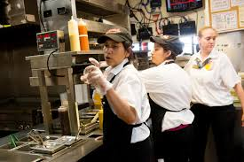
Ribosomes to Workers
Follows instructions from the boss.

Slide 7
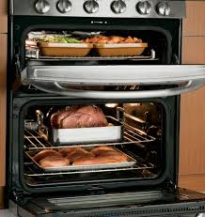
Chloroplast to the oven
Cooks the food to make the proteins so that they can be sent to the people.

Slide 8
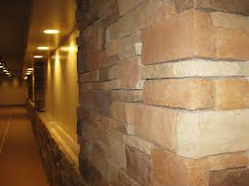
Cell Wall to Walls
Protects from weather.

Slide 9
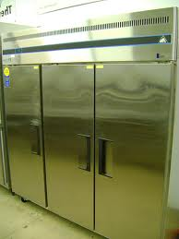
Vacuole to Freezer
Stores the food like the vacole stores water.

Slide 10
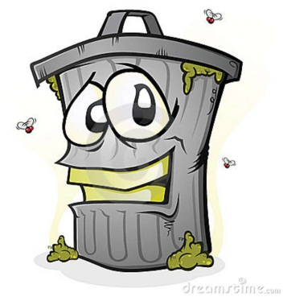
Golgi Body to Trash Can
Gets rid of the waste.

