Slide 1
Cell Organelle Presentation
By: Hunter & Justice

Slide 2
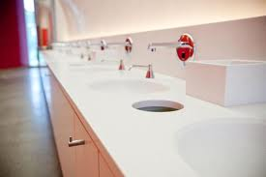
Golgi Body
It is where the waste is stored and the bathroom in the arena gets rid of waste

Slide 3
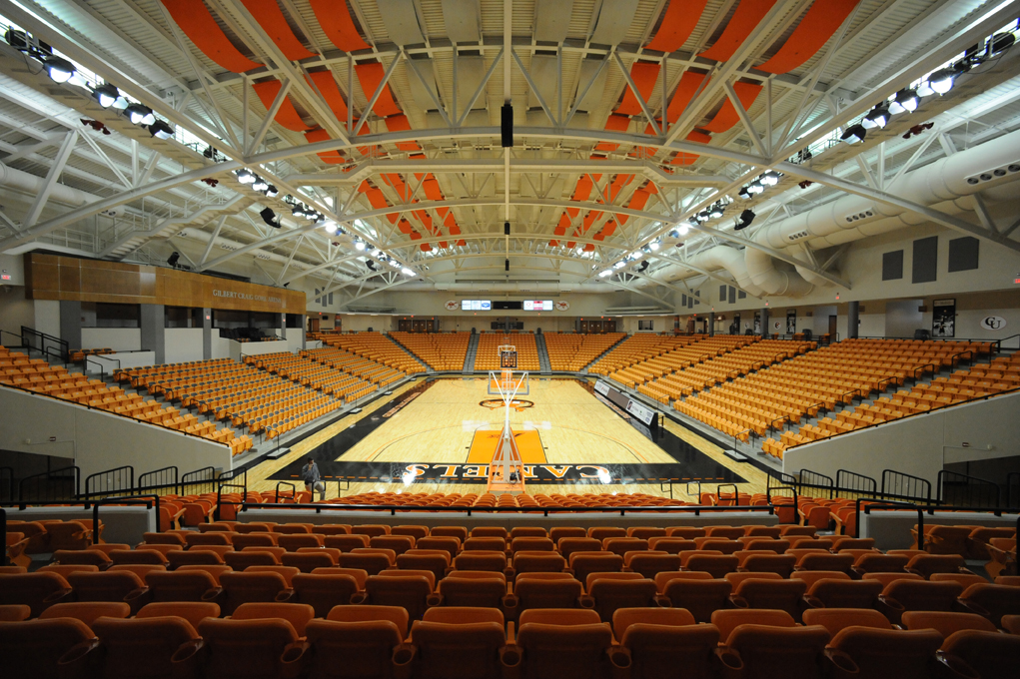
Cytoskeleton
The frame that helps keep the arena standing and is just like the bones in a human

Slide 4
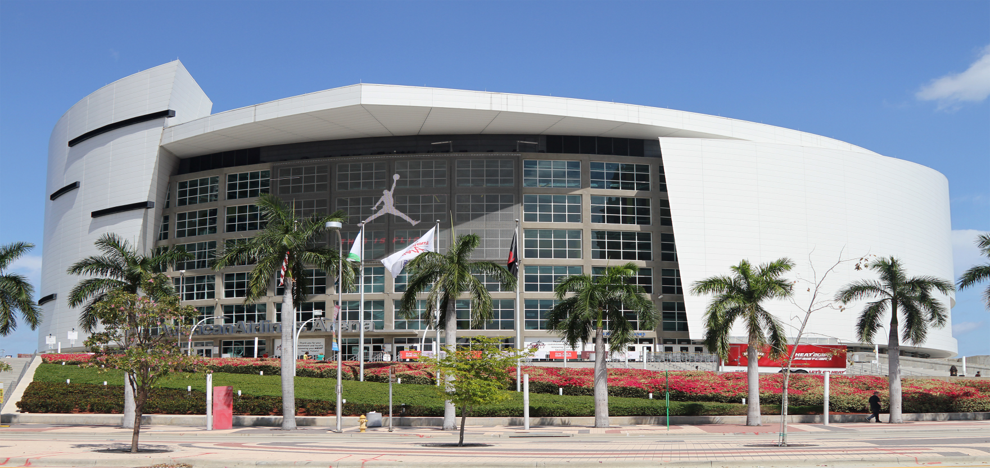
Cell wall
Protects the inside from the outside for rain and bad weather doesn’t get inside and on the court

Slide 5
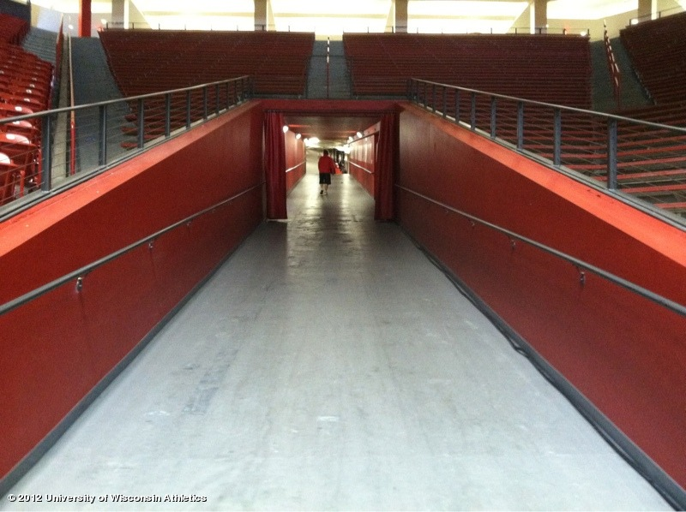
Endoplasmic Reticulum
The Endoplasmic Reticulum is were a lot of things travel from and in the arena where players travel from the locker room to the court

Slide 6
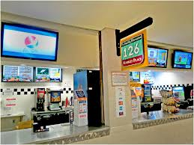
chloroplast
Chloroplast is the food you eat and in the arena you get that food from the concession stand

Slide 7
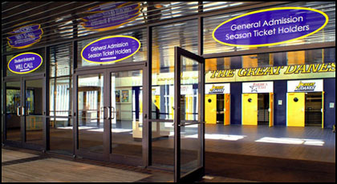
Cell membrane
The cell membrane is the door that lets people in

Slide 8
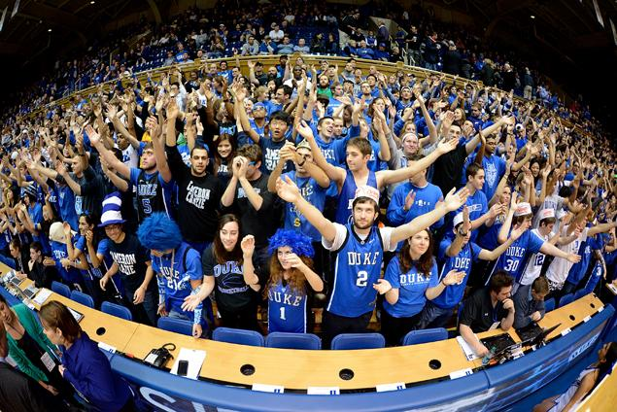
mitochondria
The people

Slide 9
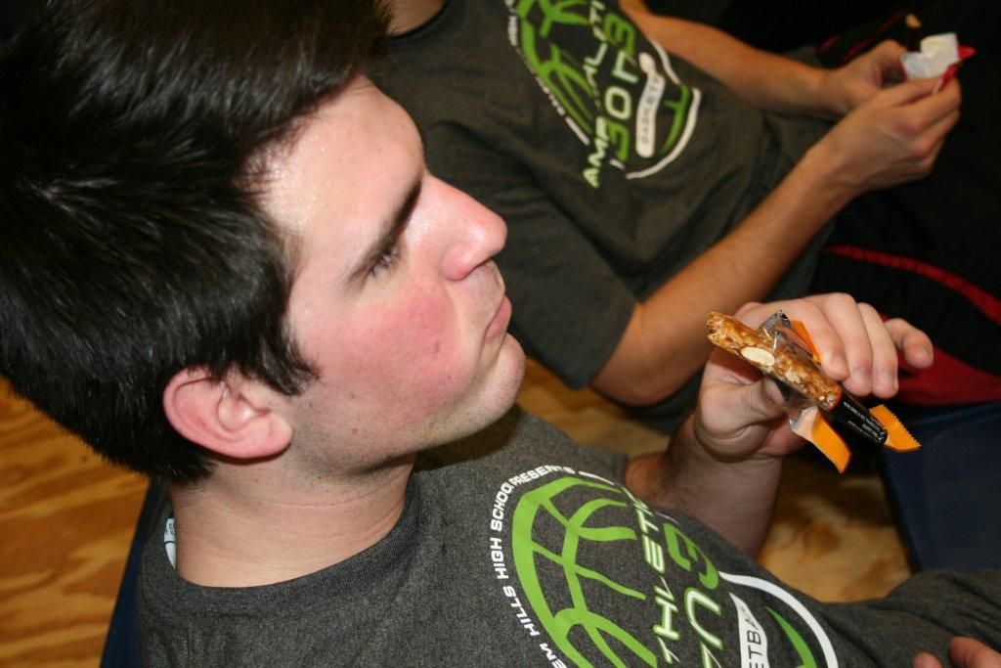
lysosome
The fans eating snacks that they got from the concessions stands

Slide 10
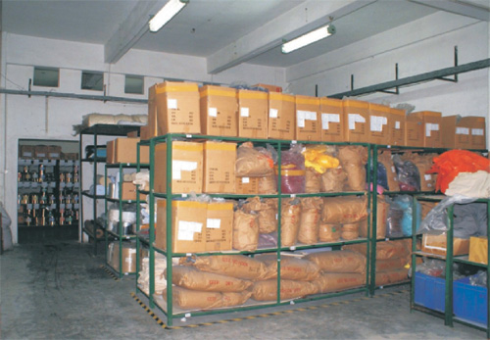
Vacuole
Were they store the food and chairs that they don’t need to use for the game

