Slide 1
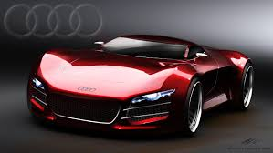
Cell Organelle Analogies
By Jake Gelnovatch and Ryan Hooper

Slide 2
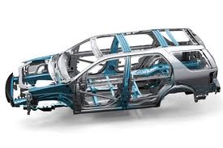
Cytoplasm
In the cell the Cytoplasm provides support to structures in the cell.
In a car the frame provides support to the car.

Slide 3
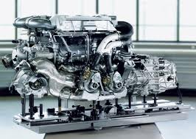
Nucleus
In the Cell the Nucleus controls the cells activities, growth, and reproduction. Also contains DNA.
In a car the Engine controls the cars movements and activities.

Slide 4
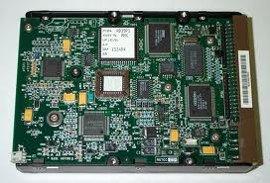
Nucleolus
Controls Ribosome production , which creates proteins in a cell.
In a car the hard drive controls your headlights at night time, how much gasoline you have left, break lights, and dashboard lights when needed.

Slide 5
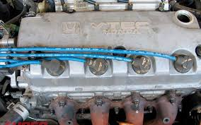
Endoplasmic Reticulum
In a cell the Endoplasmic Reticulum transports things throughout the cell.
In a car the spark plugs transport electricity from the battery to the Engine.

Slide 6
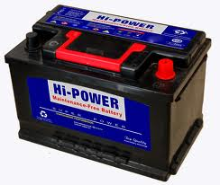
Mitochondria
In a cell the Mitochondria provides energy (ATP) for the cell.
In a the battery allows the car to start and move.

Slide 7
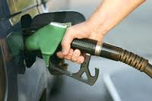
Chloroplast
In a plant cell the Chloroplast provides food for the plant.
In a car gasoline is like the food for a car.

Slide 8
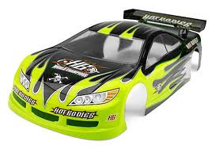
Cell Wall
In a plant cell the cell wall provides structure and support in the cell.
In a car the body provides structure and support for a car.

Slide 9
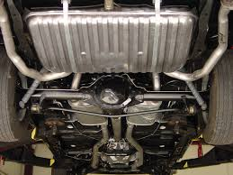
Vacuole
In a cell the vacuole stores food and water for the cell.
In a car the gas tank stores gasoline for a car.

Slide 10
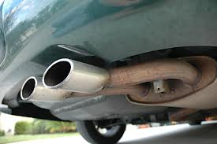
Golgi body
In a cell the golgi body gets rid of waste.
In car the exhaust pipe gets rid of bad oil that could harm the Engine.

Slide 11
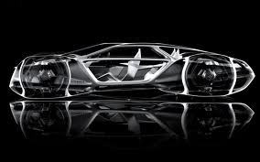
Cytoskeleton
In the cell the cytoskeleton supports the cell and allows organelles to move.
The skeleton of car provides support and allows the car to move.

Slide 12
THE END

