Slide 1
Cell Analogy to a school
By: Sean Silke

Slide 2
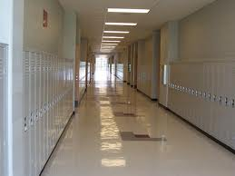
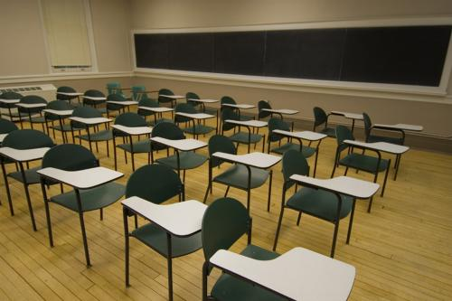
Cytoplasm to air
It goes throughout the school with everything in it.

Slide 3
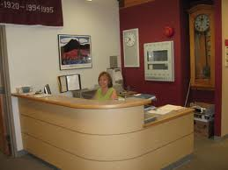
Nucleus to the Main Office
Holds the information for the students and teachers 24/7 and it controls what gets sent out to them.

Slide 4
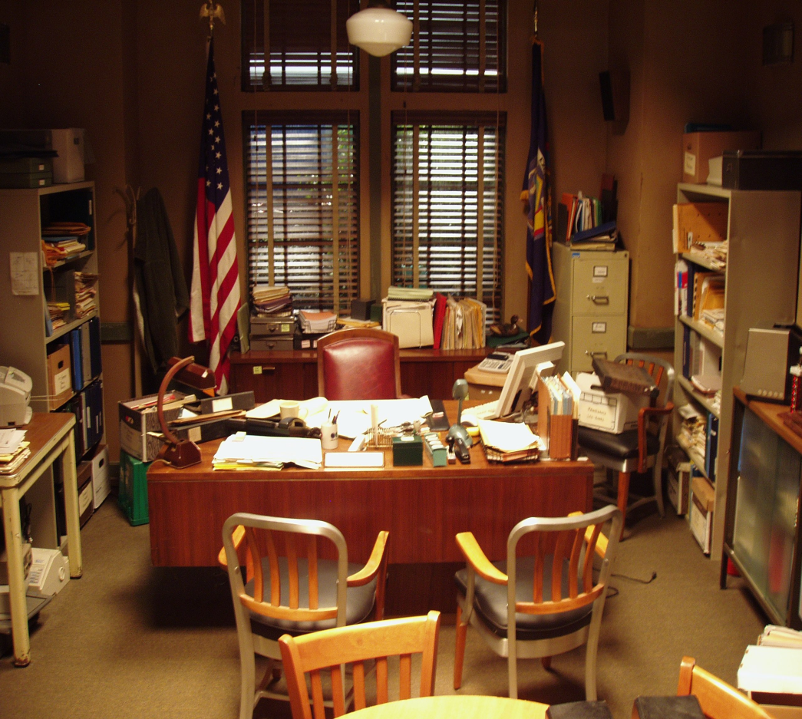
Nucleolus to the principal
The interior of the nucleus that send out the information for the cell/school.

Slide 5
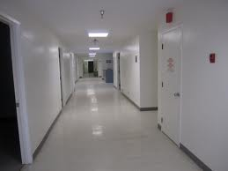
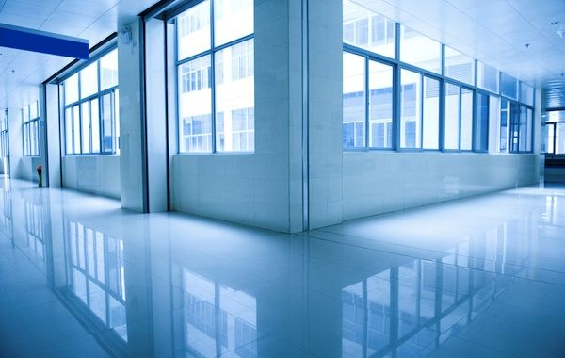
Endoplasmic Reticulum to the hall ways
They go all through the school transporting people/ribosomes to go where ever.

Slide 6
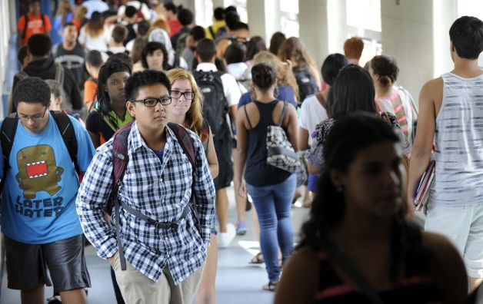
Ribosomes to students
They are located all through the school/cell.

Slide 7
Mitochondria to the trashcans
It’s where trash goes to be thrown out and will decomposed/broken down or incinerated.

Slide 8
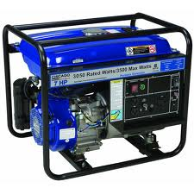
Chloroplast to the Generator room
It provides energy for the cell/ school.
School- Light/power Cell- food

Slide 9
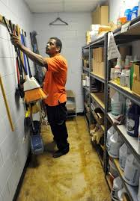
Vacuole to the janitor’s closet
It stores materials for the school/cell.

Slide 10
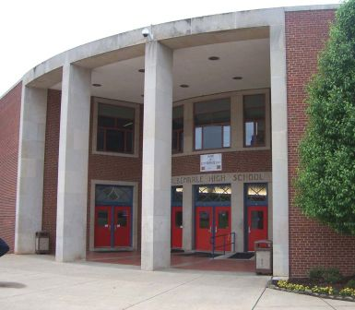
Cell wall to the walls
Protects the school/cell from objects on the outside.

Slide 11
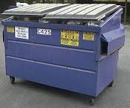
Golgi body to the dumpster
They hold waste/trash to be removed from the premises.

Slide 12
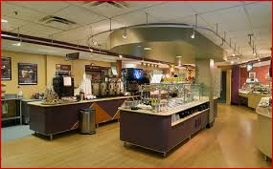
Lysosome to the cafeteria
It is where the food is brought/bought which is when it’s absorbed/eatin and then digested.

Slide 13
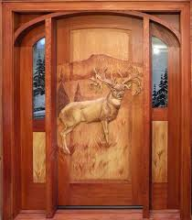
Cell membrane to the doors
Allows objects/people to enter and exit, and keeps the in or out (locked).

Slide 14
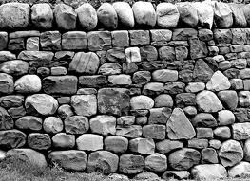
Cytoskeleton to the framing of the walls
It’s a network of proteins/frames that keeps them in place/form collapsing.

