Slide 1
Cell Analogies (Restaurant)
Sinthia & Malaney

Slide 2
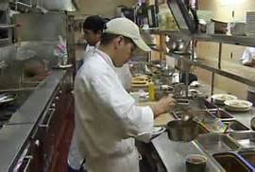
Cytoplasm: Workers
Why? The cytoplasm flows through the cell just like the workers flow through the restaurant to make it function.

Slide 3
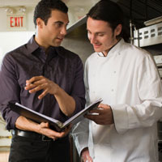
Nucleus: Manager
Why? The manager makes the decisions for the restaurant just like the nucleus makes the decisions of the cell.

Slide 4
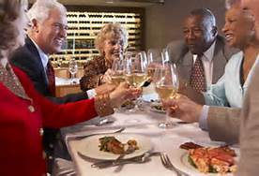
Nucleolus: Customers
Why? The customers help make the decisions work.

Slide 5
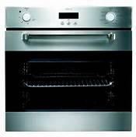
Ribosome: Oven
Why? The oven makes the food which a restaurant needs in order to work correctly.

Slide 6
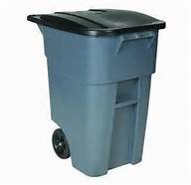
Mitochondria: Trash Can
Why? All the waste goes here and that’s where the trash can comes in.

Slide 7
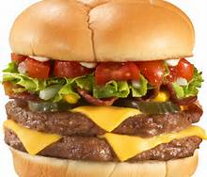
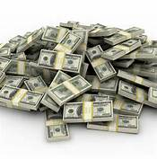
Chloroplast: The money and food cooked
Why? The food and money are what are produced to make the restaurant work/function.

Slide 8
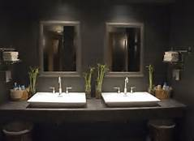
Vacuole: Bathrooms
Why? All the waste goes here.

Slide 9
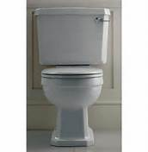
Golgi Body: Toliet
Why? The waste goes through these.

Slide 10
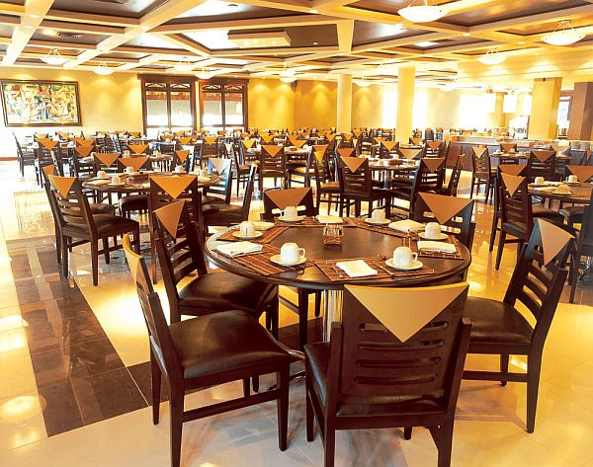
Lysosome: Tables
Why? The tables holds the food.

Slide 11
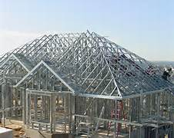
Cytoskeleton: Frame of Building
Why? It supports the structure.

