Slide 1
Cell Analogies: Airport
By: Asianna Cobbs
Nadasia Greene

Slide 2
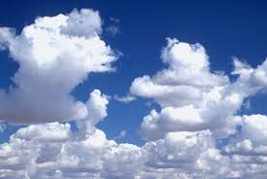
Cytoplasm
Air is everywhere in the airport like cytoplasm is everywhere in the cell.

Slide 3
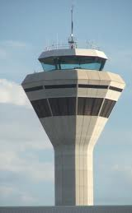
Nucleus
The control tower controls the airport and airplanes. Just like the nucleus controls the cell.

Slide 4
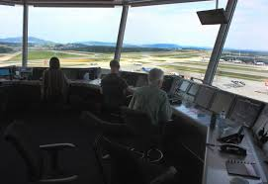
Nucleolus
The people controlling the control tower, are a part of the control tower. Just like the nucleolus is a part of the nucleus.

Slide 5
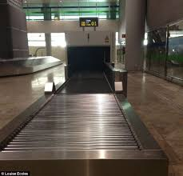
Endoplasmic Reticulum
Conveyor belts transport stuff throughout the airport just like the endoplasmic reticulum transports things through the cell.

Slide 6
Cell Wall
Tsa lets things in and out of the airport, just like the cell wall lets good and things in and out of the cell.

Slide 7
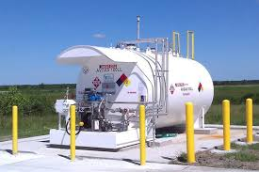
Vacuole
Fuel tanks are like vacuoles whereas they store things.

Slide 8
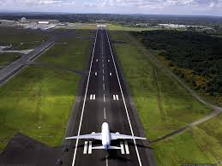
Golgi Body
The runway in an airport is like the Golgi Body because it lets things leave.

Slide 9
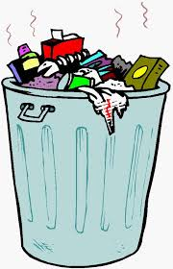
Lysosome
The garbage in the airport is like lysosomes because they both get rid of waste.

Slide 10
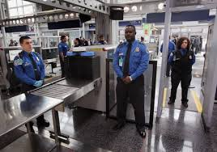
Cell Membrane
Security guards in the airport keep bad things out. In a cell the cell membrane keeps bad things out.

Slide 11
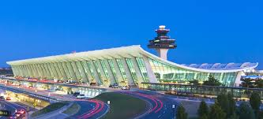
Cytoskeleton
The framework of the airport maintains the shape. The cytoskeleton maintains the shape of the cell.

