Slide 1
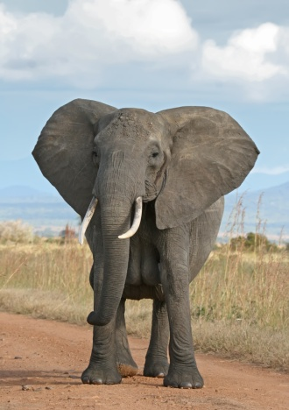
facebook
Wall
Photos
Name
Logout
African Elephant
Wall
Info
Photos
Information
Current City: Arbront
Hometown: Southern Africa
Sex: Male
Birthday: August 5,1990-September 6,2015
Relationship Status: single Married to Name or Single or Widowed from Name
Employer: Zoo
Education:
Religion: christian
Political Views: republican
People Who Inspire: Caring, loving and respectful
Favorite Quotations: Life itself is simple…It is just not always easy
Favorite Books: African pandas
Activities: Eating, suck up water, Listen to sounds
Wall
Info
Photos
Friends
Contact Information
Address: 123 African drive

Slide 2
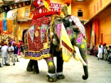
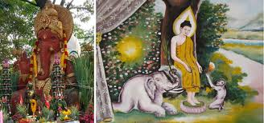
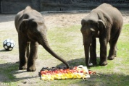
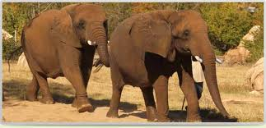
facebook
Wall
Photos
Name
Logout
Name
Wall
Info
Photos
Update status
Share
First post
Wall
Indian Elephants I love the dress they wear
August1,2013 Like · Comment · See Friendship
Info
Photos
Friends
Asian Elephants I like the different colors I come in
August 2, 2013Like · Comment · See Friendship
Friends
Friend’s name
Name of friend Comment
German Elephants I live in the best country
August 15, 2013 Like · Comment · See Friendship
Friend’s name
Name of friend Comment
Friend’s name
Virginian Elephants It is so nice to see beautiful trees
September 6, 2013 Like · Comment · See Friendship

Slide 3
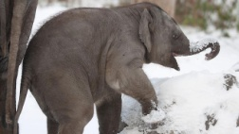
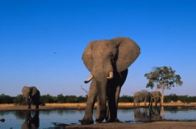
facebook
Wall
Photos
Name
Logout
Name
European Elephant I can do so many tricks
September20, 2013Like · Comment · See Friendship
Friends
Siberian Elephants Playing in snow is so fun
September 22, 2013 L ike · Comment · See Friendship
Friend’s name
Saharan Elephant The water here taste so good
Month day, year Like · Comment · See Friendship
Friend’s name
Name of friend Comment
Friend’s name
Name of friend Comment
Name ninth post
Month day, yearLike · Comment · See Friendship

Slide 4
facebook
Wall
Photos
Name
Logout
Name
Name tenth post
Month day, year Like · Comment · See Friendship
Friends
Name of friend comment
Name eleventh post
Month,day, yearLike · Comment · See Friendship
Name twelfth post
Month,day, yearLike · Comment · See Friendship
Name of friend comment

Slide 5
facebook
Wall
Photos
Name
Logout
Name
Wall
Info
Photos
Photos of Name 6 Photos

