Slide 1
Cells
*Simple*
Prokaryotes
*Do not have a nucleus
*Do not have membrane bound organelles
*Complex*
Eukaryotes
*Have a nucleus
*Have membrane bound organelles
Bacteria
* cell wall
*large central vacuole
*chloroplasts
Plant Cells
Animal Cells

Slide 2
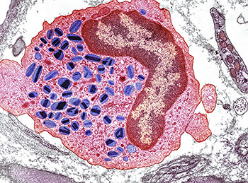
Eukaryotic Cell Organelles
Most organelles are found in both plant and animal cells.
*found only in plant cells
**found only in animal cells

Slide 3
Cell Wall*
Structure:
-surrounds cell membrane of
plant cells
-composed of polysaccharides
(ex. cellulose or chitin)
Function:
-provides structure/shape for
plants
-protects cells from pathogens
-prevents cells from bursting,
when water enters the cell

Slide 4
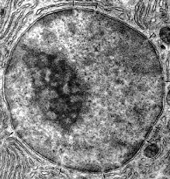
Cell Membrane
Structure:
-surrounds cell contents
-”fluid-mosaic”model: double layer of phospholipids, with
embedded proteins
Function:
-protects the interior of cell from
the environment
-provides structure for the cell
-allows for the passage of
materials into and out of
the cell “selectively permeable”
-has receptors that allow cells
to communicate

Slide 5
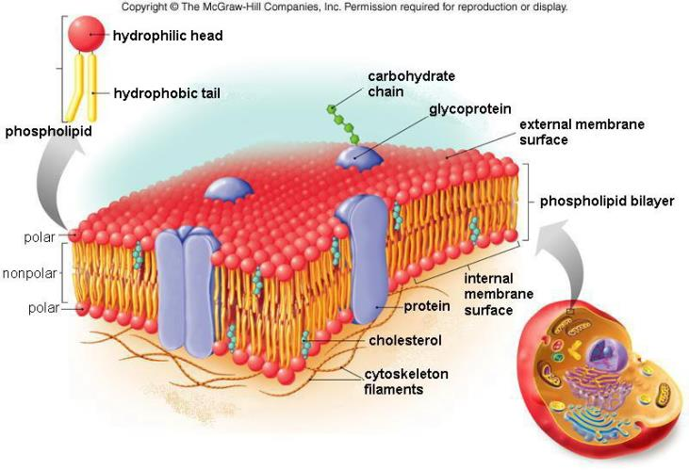
Fluid-Mosaic Model of Cell Membrane

Slide 6
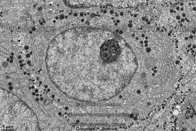
Nucleus
Structure:
-contains most of the cell’s genetic
material(DNA)
-surrounded by a double layered mem-
brane called the nuclear envelope
-has large pores on surface to allow
materials to pass in and out of
nucleus.
-contains the nucleolus, where ribo-
somes are made
Function:
-controls all cell activities (growth &
reproduction)
-produces RNA and ribosomes

Slide 7
Cytoplasm
Structure:
-is found between the cell mem-
brane and nucleus
-contains all cell organelles
-composed mostly of water with
many dissolved substances
Function:
-provides support to structures
in cell
-allows materials to move
around the cell

Slide 8
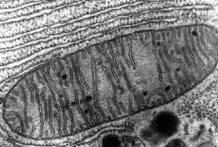
Mitochondria
Structure:
-has a double membrane
surrounding it
-”bean” shaped
-contains some of the cell’s DNA (from mother)
Function:
-site of cellular respiration,
where food is broken down
to produce ATP (energy for
the cell)

Slide 9
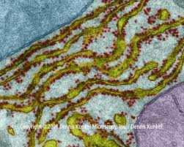
Endoplasmic Reticulum
Structure:
-series of membranes through
out the cell
-Rough ER is covered with
ribosomes
-smooth ER does not have ribo-
somes on it’s surface
Function:
-proteins produced by ribosomes
are transported directly into ER
-proteins are folded and modified
-produces membranes

Slide 10
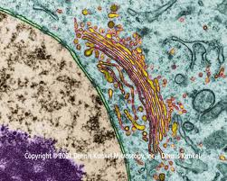
Golgi Body
Structure:
-A stack of flattened membranes
Function:
-packages, modifies, and sorts materials in the cell

Slide 11
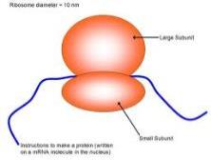
Ribosomes
Structure:
-small particles found attached to
the nucleus or ER or floating in
the cytoplasm
-composed of 2 parts
-composed of rRNA and proteins
Function:
-site of proteinsynthesis

Slide 12
Vacuole
Structure:
-membrane bound structure
-large central vacuoles found in
plant cells
-uncommon and smaller in animal
cells
Function:
-central vacuoles in plants hold
water and have high pressure to
give plant structures support
- storage for various substances

Slide 13
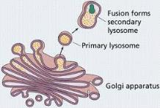
Lysosome
Structure:
-membrane bound structures that
contain digestive enzymes
Function:
-digest waste materials and un-
wanted foreign bodies(like
bacteria)

Slide 14
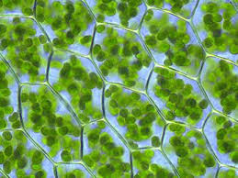
Chloroplast*
Structure:
-contain chlorophyll, which give them
their green color
-contain stacks of membranes
Function:
-site of photosynthesis(food pro-
duction) in plants and algae

Slide 15
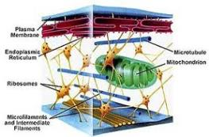
Cytoskeleton
Structure:
-composed of microtubules and
microfilaments
-found throughout cell
Function:
-supports cell
-allows for organelles to move
throughout the cell

Slide 16
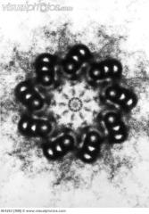
Centrioles**
Structure:
-2 rod-like structures found near
the nucleus
-composed of bundles of micro-
tubules
Function:
-organize spindle fibers during
cell division in animal cells

